Slide 1
Analog and digital Backflow test kits By Nicole Everhart Mike Lueck Mid-West® Instrument

Slide 2
Goals For the Presentation
I. Define the main components of pressure-sensing instruments
II. Define and discuss two types of test kits
A. ANALOG Pressure Gauge
Elastomer diaphragm / magnetIC coupling
B. Digital Pressure Gauge
Capacitive differential sensors
III. Answer any questions

Slide 3
Pressure Sensing Common Components
All backflow test kits contain These three main components
Keeps the system pressure and process fluid inside the instrument.
Pressure sensing element
Converts pressure changes into an “output” that can be measured.
3. Indicator
The “mechanism” that converts the “output” of the pressure sensing element to an indicated value of known units.
Pressure containing element

Slide 4
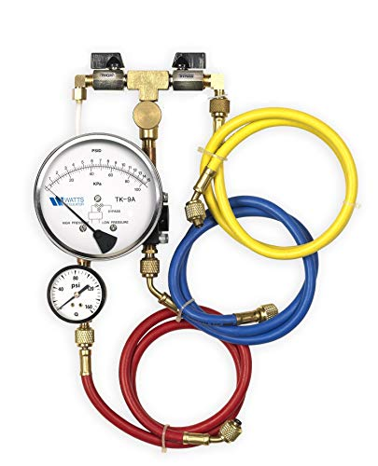
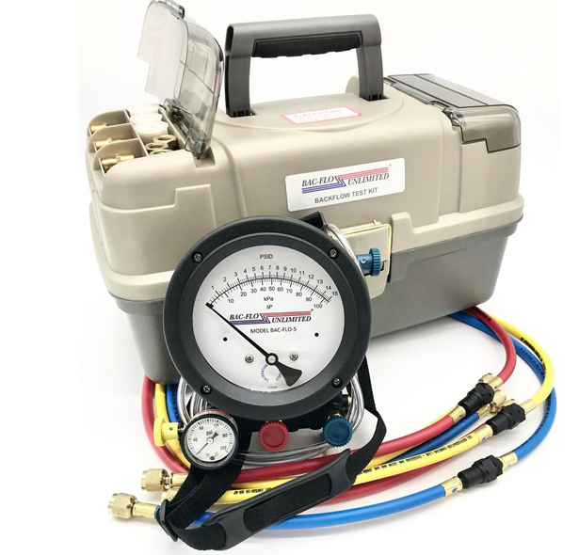
Analog backflow test kits

Slide 5
Mechanical Differential Pressure Gauges
1. Pressure containing elements
The sensing element separates high pressure and low-pressure housings that contact and contain the media.
2. Pressure sensing element
An elastomer diaphragm that Converts the pressure differences between the high and low sides into linear motion via magnetic coupling.
3. Indicator
Converts linear motion of the diaphragm into rotary pointer motion indicated against a graduated dial arc.

Slide 6
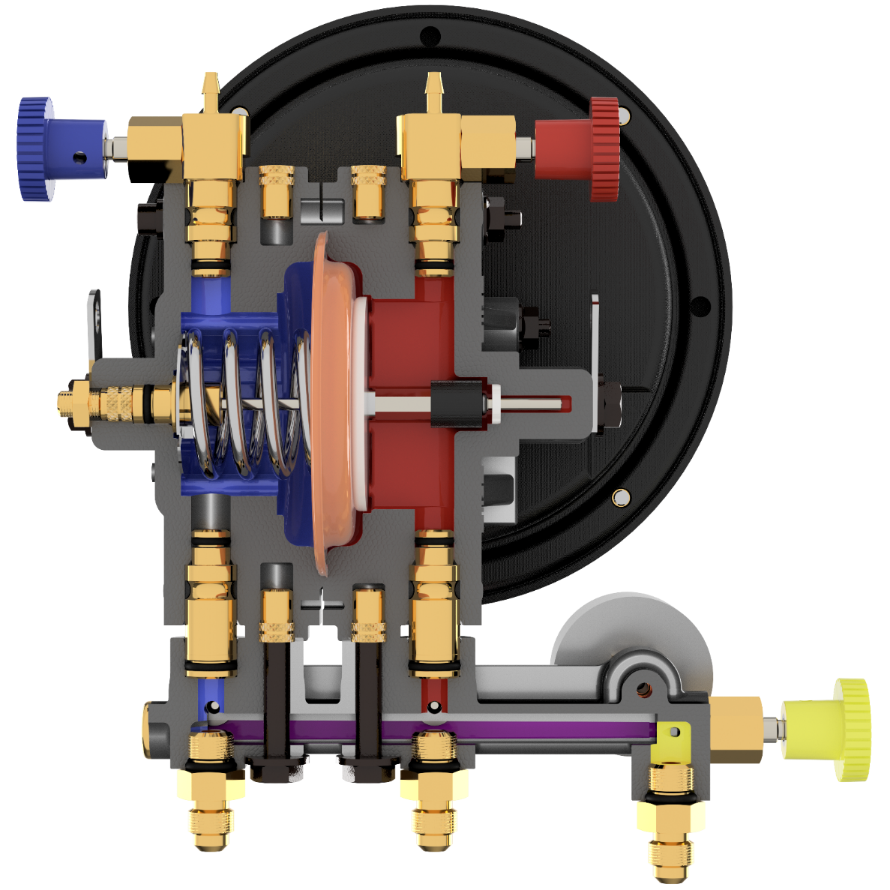
Differential Pressure Gauge Components
Indicator
Pressure containing elements
Pressure Sensing element

Slide 7
5 valve Backflow test kit
Low Bleed Valve
High Bleed Valve
DIAPHRAGM Support Plate
Range Spring
Driver Magnet
DIAPHRAGM
HIGH-Side Pressure Housing
Contoured for over-pressure protection
Low-Side Pressure Housing
Contoured for over-pressure protection
Low-Side Control
Bypass Control
High-Side Control

Slide 8
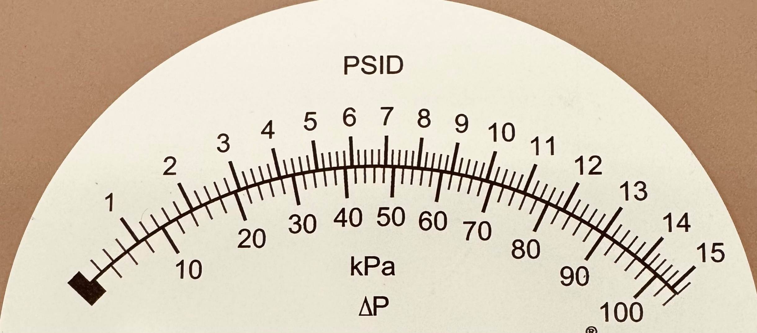
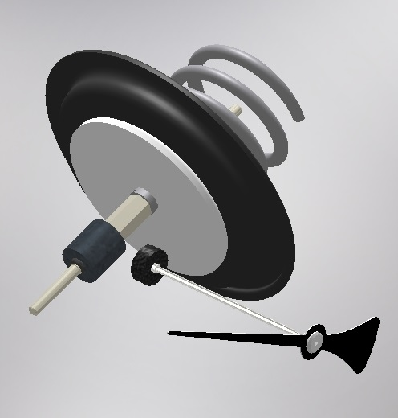
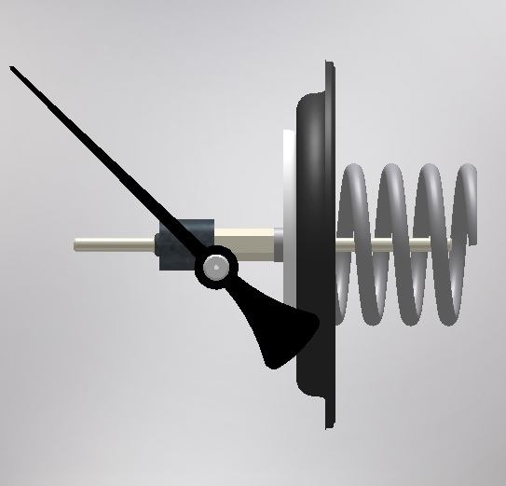
magnetic coupling

Slide 9
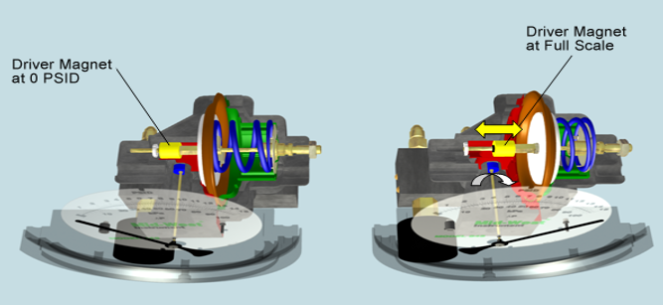
magnetic coupling

Slide 10
Notes:
Put it all together and this is how a diaphragm differential pressure gauge works.
(Just let the video run) (You can click inside the gauge to re-run the video if you would like)

Slide 11
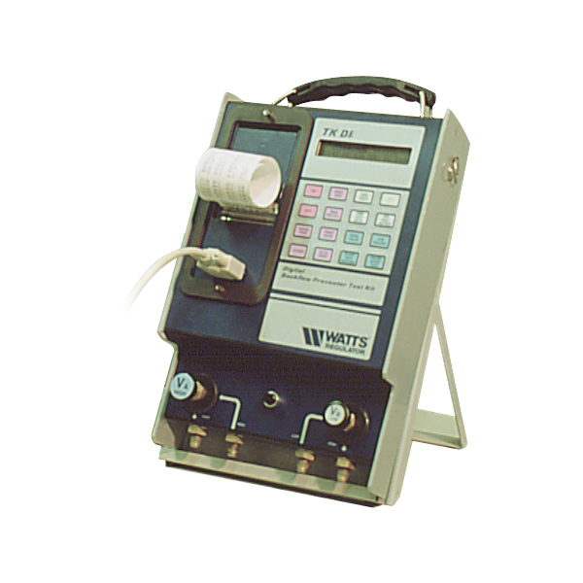
Digital backflow test kits

Slide 12
Digital Pressure Gauge Test Kits
1. Pressure-containing elements
each transducer has its own housing
2. Pressure sensing elements
two pressure transducers that convert pressure changes to an electrical output. (voltage, inductance, capacitance, etc.)
3. Indicator
a microprocessor and circuitry designed to convert the electrical output to a digital pressure readout that can be displayed on an LCD, and one version had a thermal print out.

Slide 13
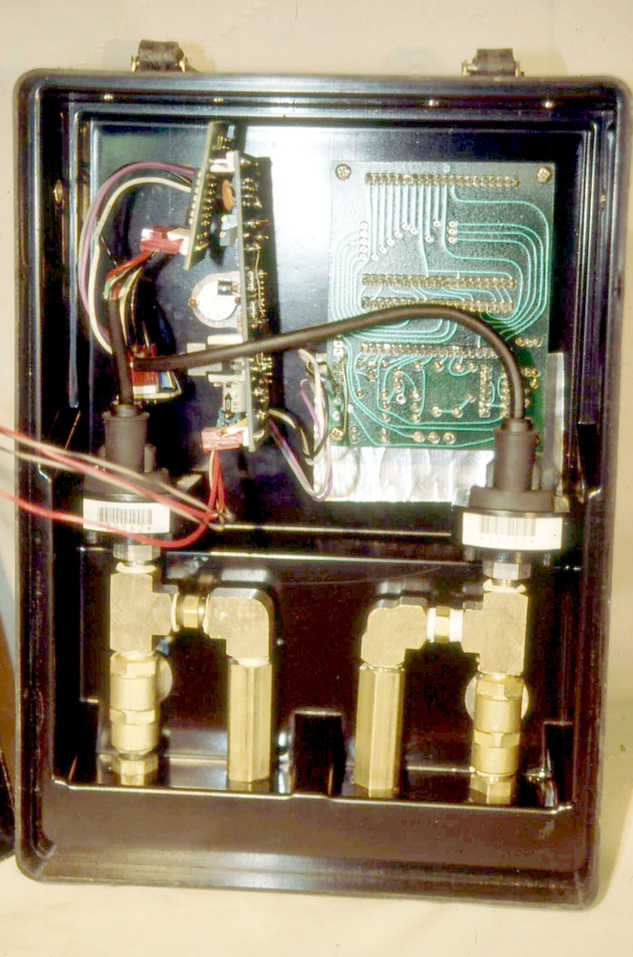
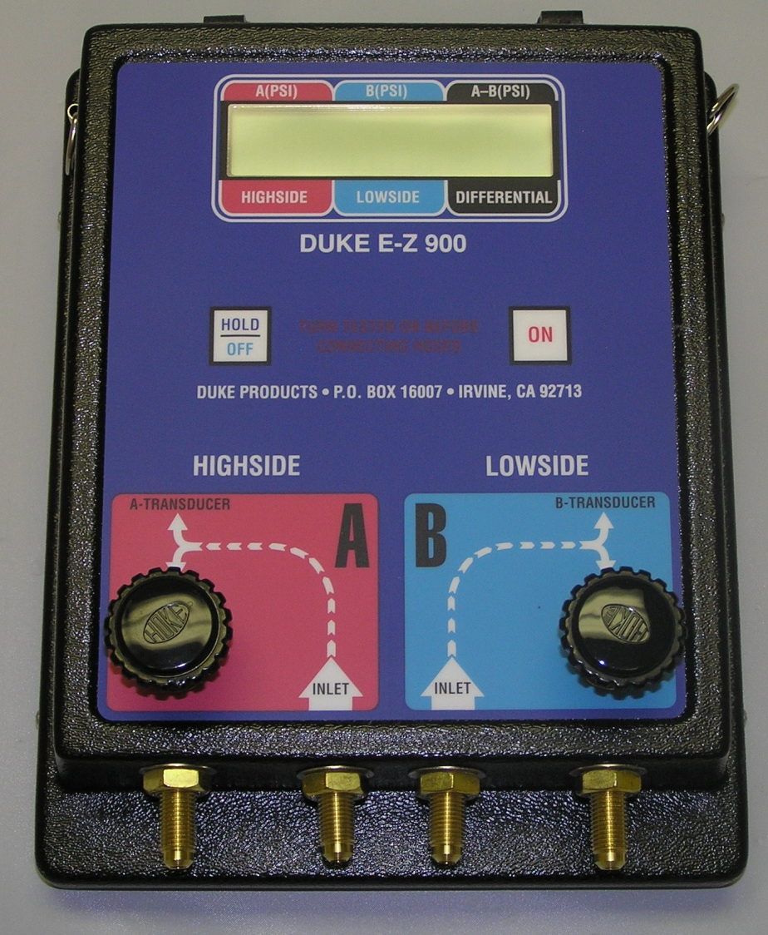
History of Digital
Pressure transducer sensing technology existed Since the 1980s.
Application of This technology into Backflow test kits followed shortly after
Notes:
Two line pressure sensors instead of a dp sensor in original designs less accurate

Slide 14
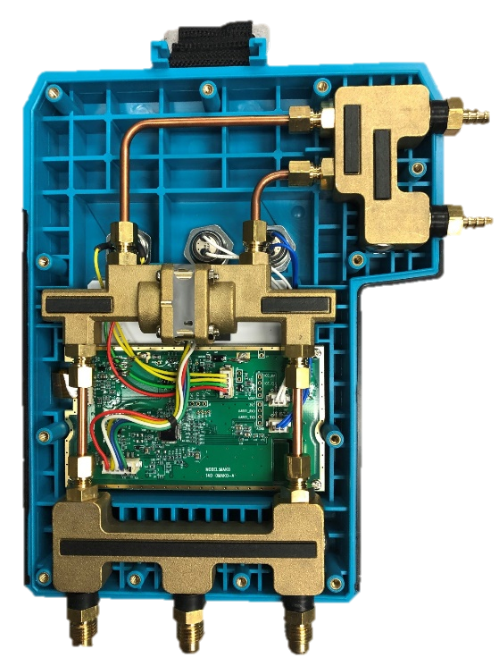
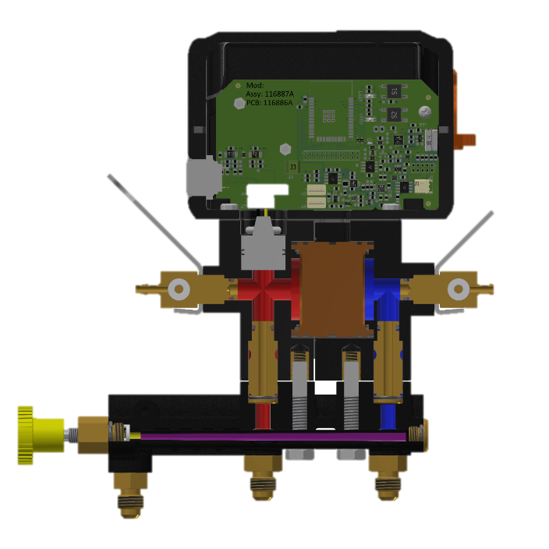
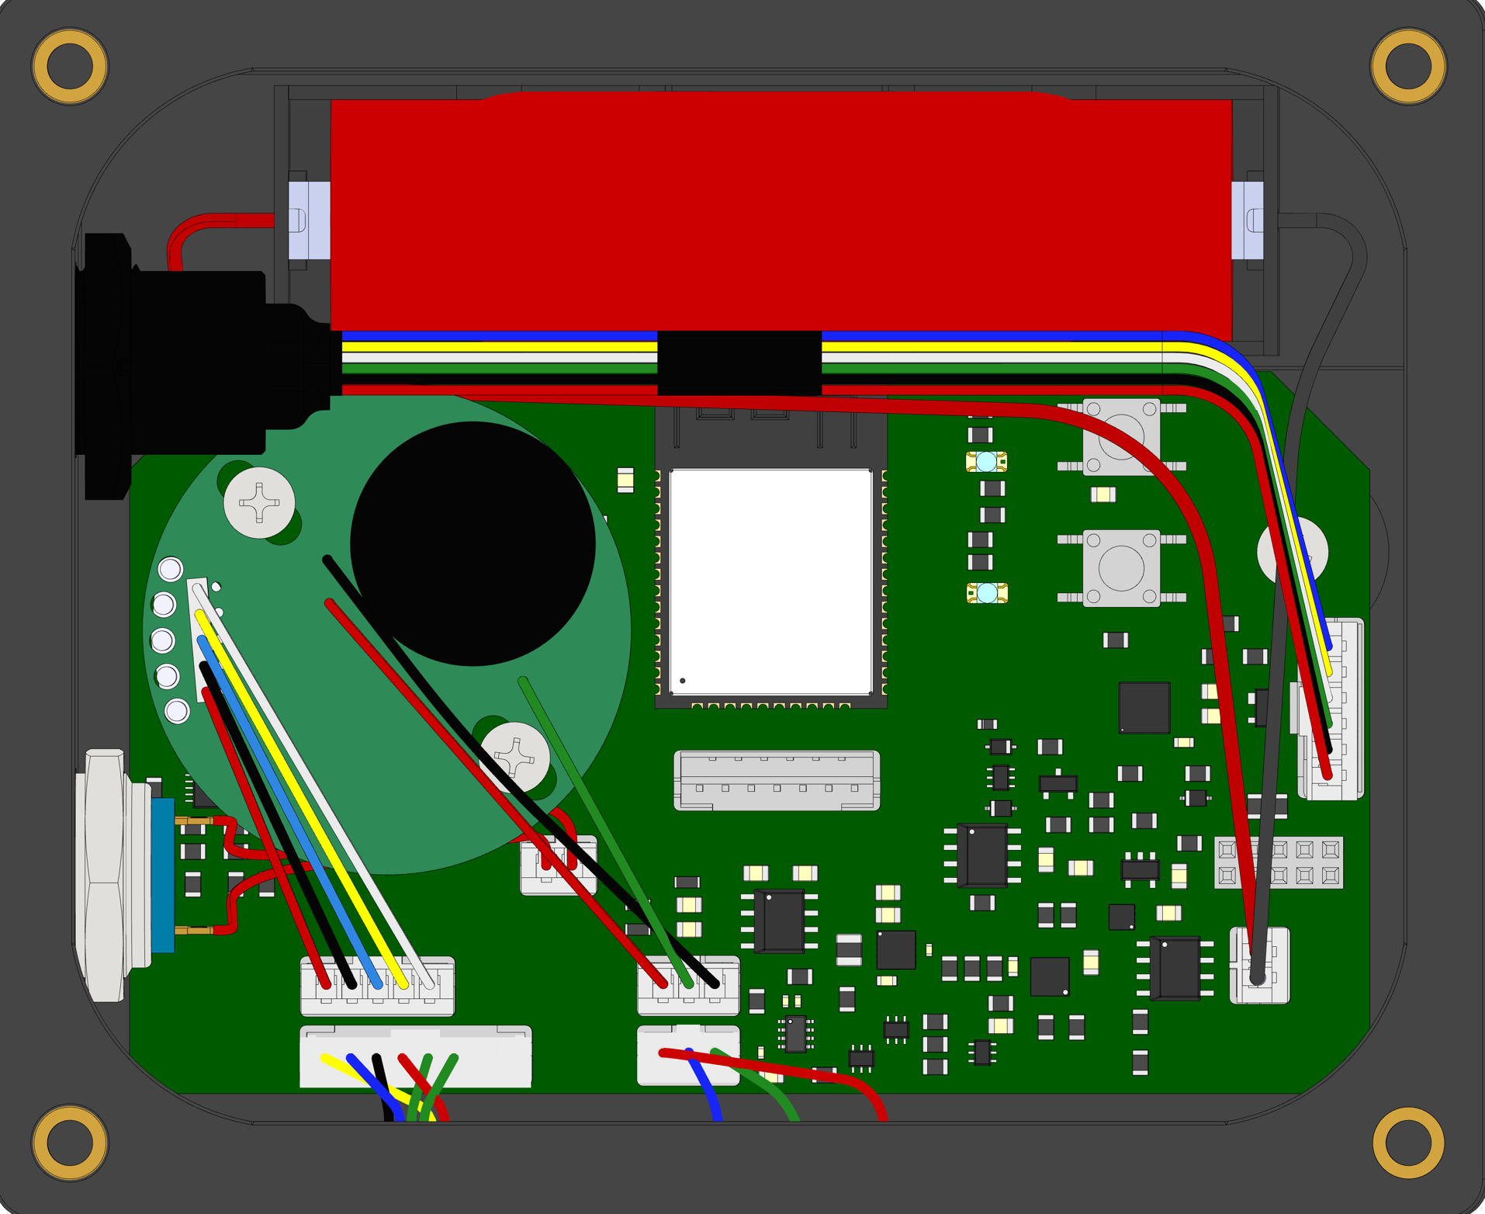
Digital ΔP Test Kit Components
Sensing elements
Pressure Housings

Slide 15
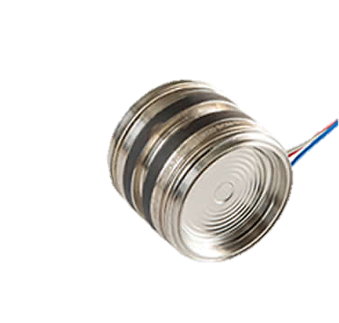
How Digital ΔP Pressure Sensors Works
Capacitance (Signal) from
RED WIRE = BLUE WIRE
Capacitance (Signal) From
RED WIRE >> BLUE WIRE
@ 0 PSID
@ 15 PSID
Very small displacement compared to Manual gauge

Slide 16
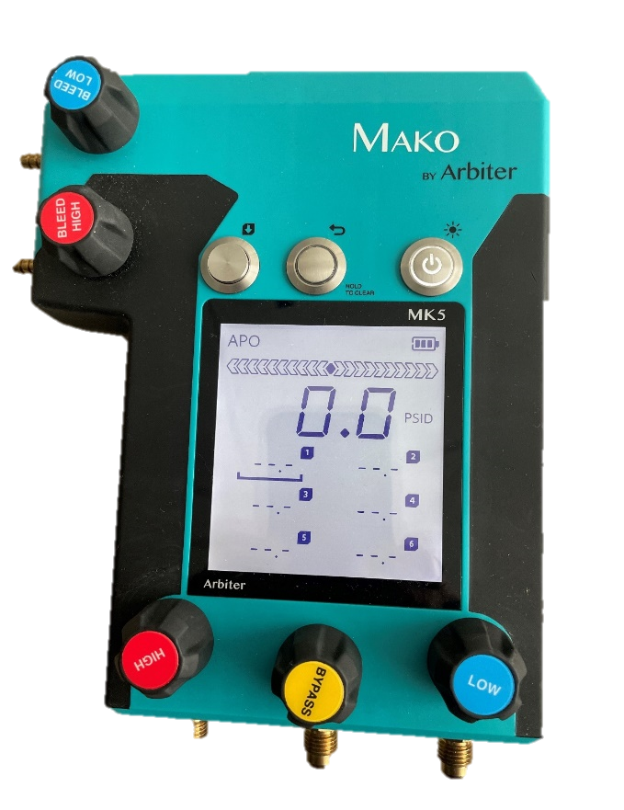
Digital ΔP Test Kit Indicator
Indicators
CAPTURED READINGS
Notes:
Store and create databases of past tests and customers. Once data is digital, “there's no limits to what you can do with it” lcds, phone apps, web interfaces, and possible future in AI.

Slide 17
The Digital Gauge Circuit
Sensor Signal
Micro-Processor
Bluetooth/ Wi-Fi/ or Cable
Digital Data
DP, LP, Battery%,
Temp, etc.
Capacitance to Digital Converter
Battery and Charging
Digital Data
Analog to Digital Converter
Temperature Sensing for temp compensation
Notes:
Relate to headphones and other digital devices they are used to.

Slide 18
Circuit board
Battery
Bluetooth and Wireless Antenna
USB Charging
Capacitance to Digital Converter
Processor
Wires From Sensors
Notes:
Compare to magnetic coupling, increased complexity and sophistication (good and bad!!!)
Software updates

Slide 19
Review: Manual vs Digital
Pressure Housing
More Volume and larger displacement
Less Volume, very small displacement
Pressure Sensing Element
Diaphragm with range spring
Capacitive differential pressure sensor
Indicator
Diaphragm displacement combined with magnetic coupling to a dial pointer
Capacitive sensor to a digital value for display on an electronic device
Manual
Digital
Notes:
Maybe review few pros/cons never ‘replace’ manual oil refineries (no electronic devices)

Slide 20
What Remains the Same
Physical Test Time – Still have test cocks to bleed, adapters to install, Hoses to connect, components to test, Assembly returned to as found state, Etc.
Both versions resolve 0.1 PSID
Both designs have the same manifold configurations –water in the bottom, air out the top
Both versions work with existing test procedures
Both Designs require accuracy verification, recommended annually
Does not eliminate false or inaccurate test reports.

Slide 21
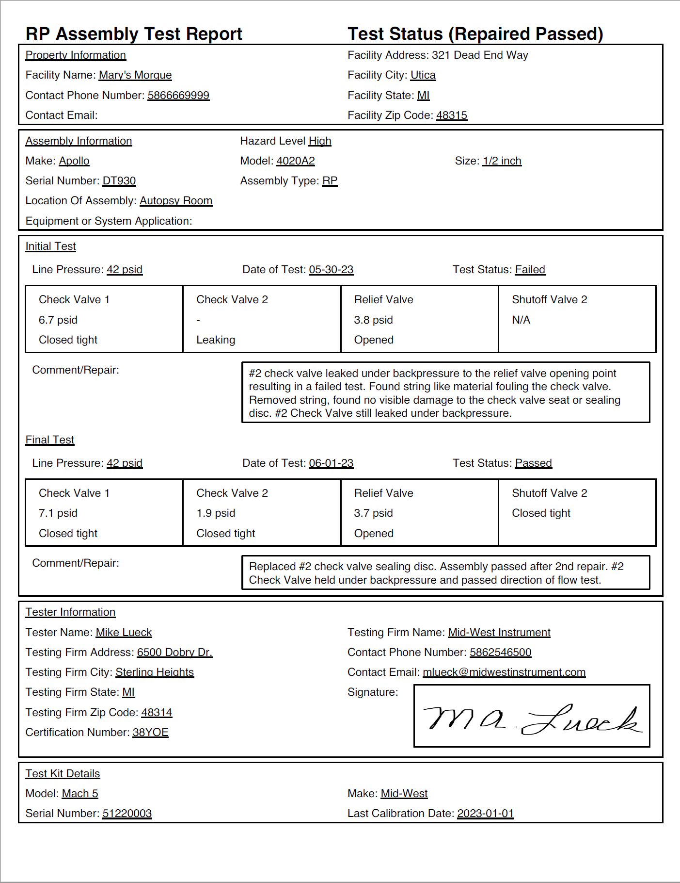
Why Now and What’s Next
Save test data to always have it available at anytime
Generate PDFS to Drive more commonality on test submission forms and procedures.
Download results from cloud and Integrate with other software
Municipalities
Notes:
Digital test kits do not make physical testing faster, but with digital data, filling out forms and manually entering data will be faster. This feature was unavailable when digital test kits were first invented, and therefore the industry didn’t adopt them. Now with cell phones, connected devices, and data management software's the value of digital kits is created

Slide 22
The Players in Cross Connection control
Purveyors
Tester
Device Owner
Testing Company
How Can we make testing easier!?
Communication between purveyors, testers, and backflow device owners can occur in multiple ways and is constantly evolving away from paper copies to more productive and efficient tools, including cross-connection database management software.
Digital testing is just one step in many toward streamlining backflow device testing and supporting the clean water initiative.

Slide 23
Questions?

