Slide 1
State of The State A Survey of Florida CCC Programs
Bradley Hasseler
02/21/2024

Slide 2
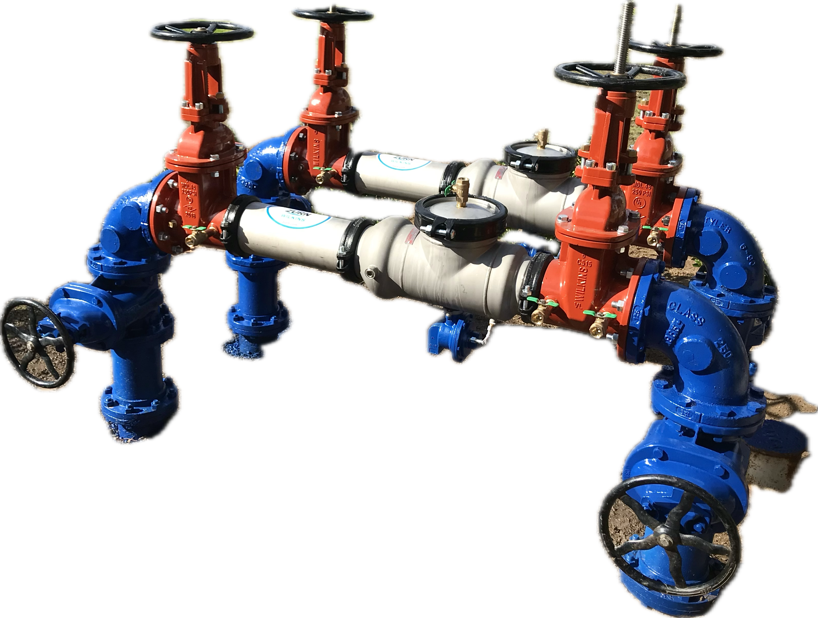
Agenda
Meet the presenter​
Background​- consent decree/research
A look at FAC 62-555.900 form 13
How many commercial backflows should I have?
Irrigation System Protection
Residential Protection
Reported Cross Connections
Testing Compliance
Key Takeaway

Slide 3
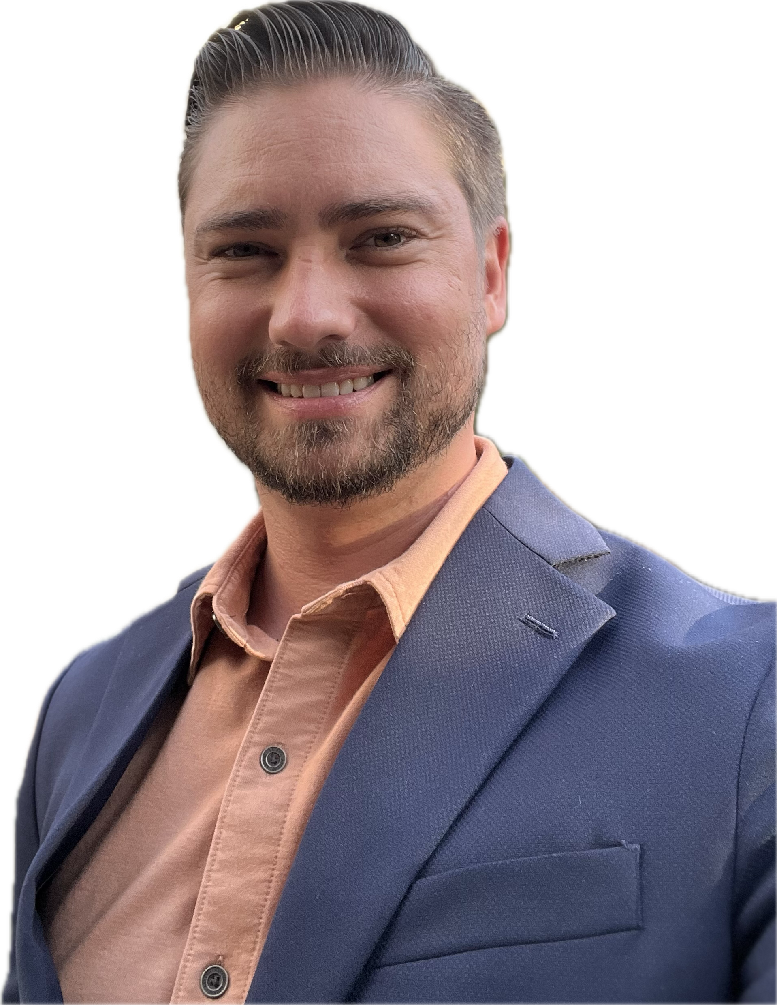
Bradley Hasseler -District Manager Waterworks | Fire Protection | Irrigation
12 years backflow tester | Utility Consultation
2.5 years Cross Connection Program Mgr – Delray Beach
~ 1 year Territory Sales Manager
15 years Backflow NERD!
​
State of the state: a survey of Florida cross connection control programs

Slide 4
Background
Assisted new DB administration in establishing a CC program
Researched Neighboring Utilities in county
Began researching entire state in July 2023
January 2024 all PWS 62-555.900 form 13 gathered and compiled
Survey only covers PWS serving 10,000 or more
​

Slide 5
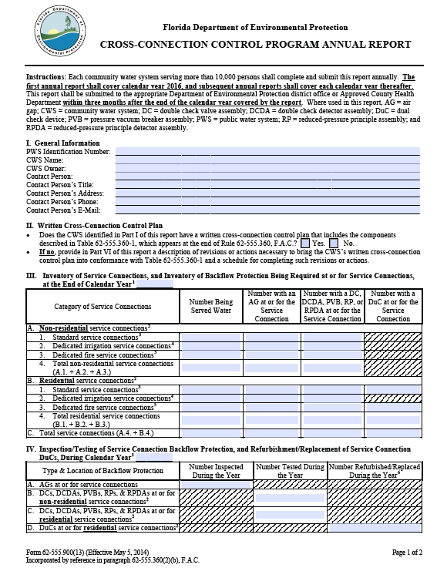
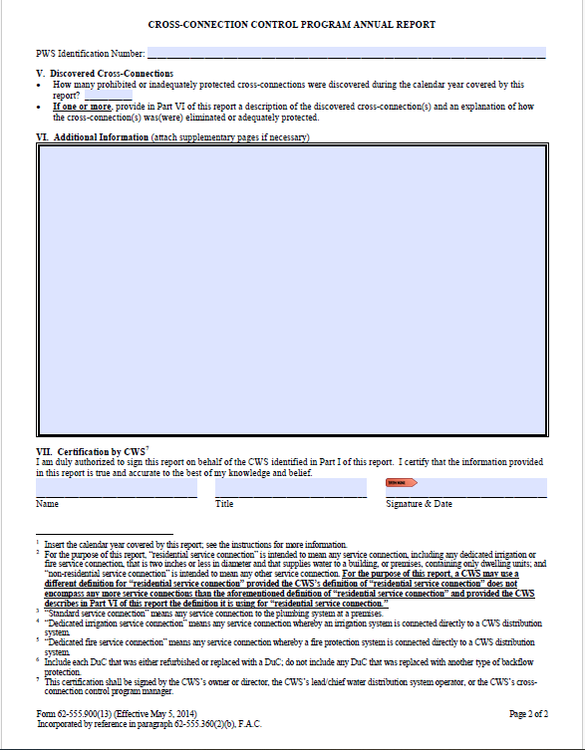

Slide 6
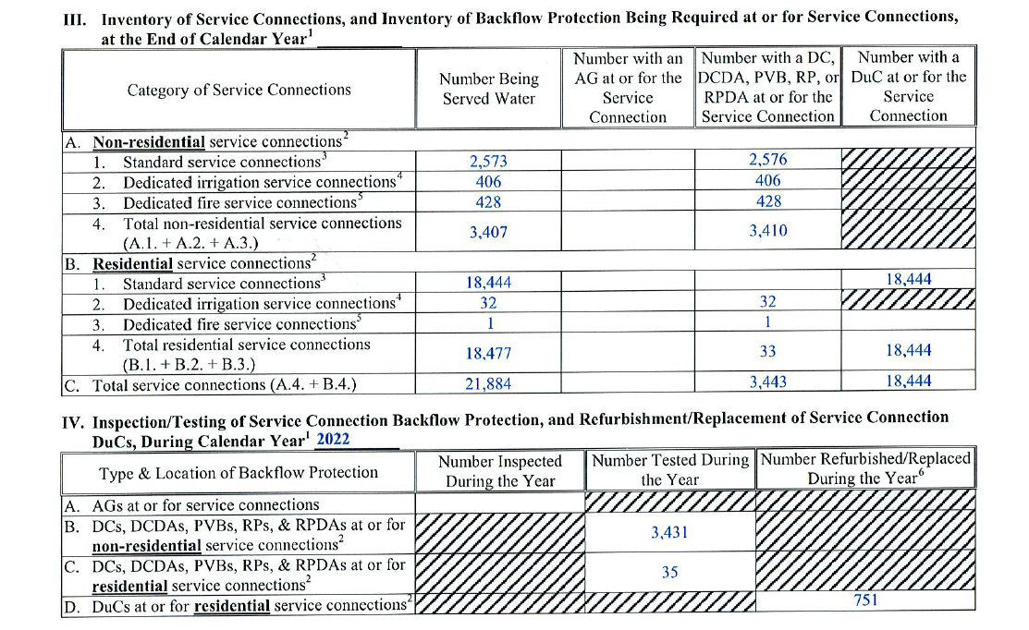
1:1
1:1
1:1
2:1
10%

Slide 7
Public Records Survey
222 Public Water Systems in the Study (10K+)
46 Counties
17,878,431 population served
5,717,219 total water service connections
1.2 Million Testable Backflow Prevention Assy
1.1 Million Residential Dual Checks

Slide 8
Commercial Services (Non-Residential)
576,198 total commercial meters
433,677 total BP Assemblies
75% of ALL have Assemblies State-wide
IS THIS OK??

Slide 10
Dedicated Irrigation Services
Let’s talk about Irrigation Systems…
*hold on to your neighbor*​

Slide 11
New York times Feb 13, 1972, Page 31
“The mystery of the epidemic of infectious hepatitis that incapacitated the Holy Cross College football team in 1969 have been unraveled by a team of doctors”
Sports field irrigation fed from six “underground faucets”
A two-alarm fire drew down city pressure: Backsiphonage. Irrigation waters contaminated with urine backflowed into school plumbing system.
Hours later thirsty teammates would contract hepatitis from drinking out of water fountains at the field.
90 of the 97 men on the Holy Cross football team got hepatitis by drinking contaminated water.

Slide 12
FAC 62-555.360 Table 2
Premises where there is an irrigation system that is using potable water and that is connected directly to the CWS’s distribution system via dedicated irrigation service connection

Slide 13
FAC 62-555.360 Table 2
At or for a residential or non-residential service connection: PVB if backpressure cannot develop in the downstream piping; or RP if the backpressure could develop in the downstream piping.

Slide 16
Backflow Lottery​
Florida has
169,138
Holy Cross Events waiting to happen
​
State of the state: a survey of Florida cross connection control programs

Slide 17
Residential Services
5,380,314 total residential meters
756,245 total Backflow Assemblies
1.1 million Residential Dual Checks
Almost 1.9 million assy. + devices
About 35% are protected
IS THAT OK???

Slide 20
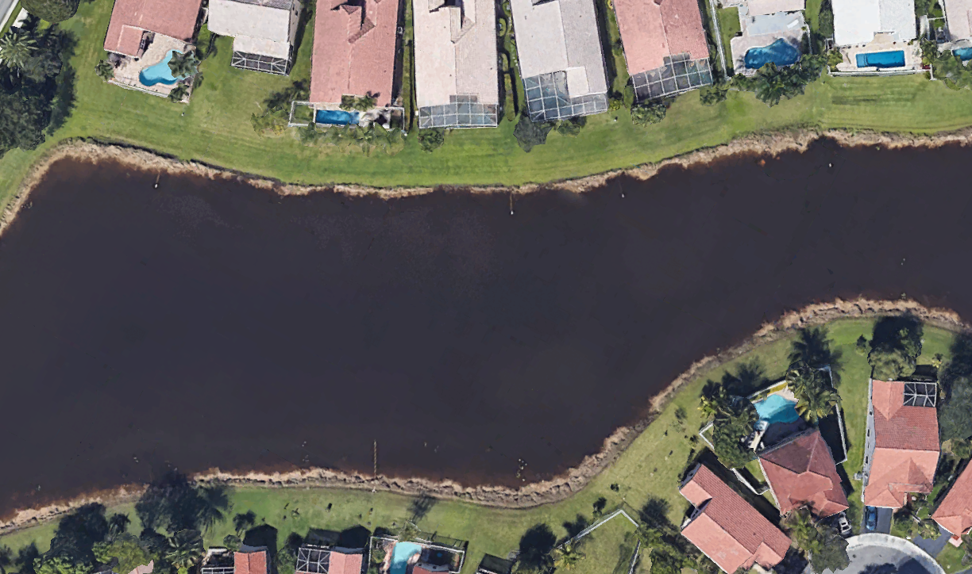

Slide 21
Residential Services
The PWS shown (and many others) is reporting 0 backflow preventers on residential meters…
Average system 48%
Over 60 PWS have 10% or LESS protected

Slide 22
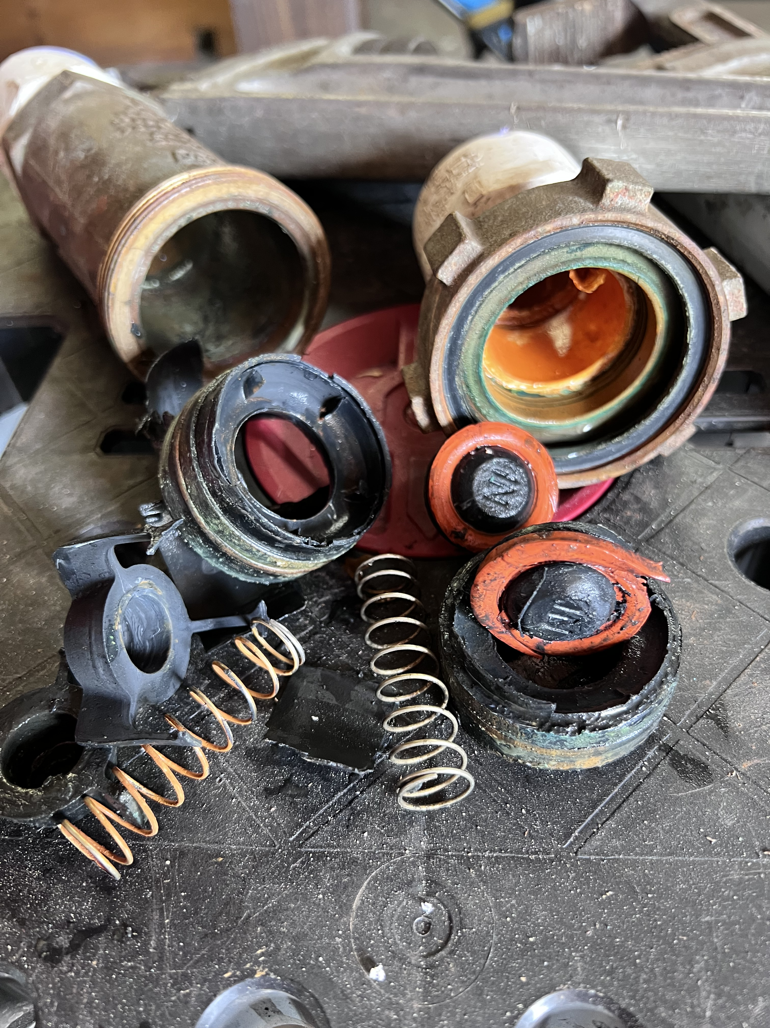
Residential Dual Check
1.1 Million in the ground
52,248 replacements/refurbishments in last recorded year
Only about 5% get replaced annually.
The state is on pace for 20-year DuC service life.
Dual Checks are not protection, they are only legal indemnification!

Slide 23
Testing Compliance
Commercial Backflows must be tested annually
Legal Target: 100%/yr
567,198 NR assemblies
Only 308,739 tests
258,459 did not get tested last year! 46% of all commercial backflows
​

Slide 24
Testing Compliance
Residential Backflows must be tested biennially
Legal Target: 50%/year
756,245 Residential Backflow Assemblies
375,995 tests reported
49% of all residential backflow was tested: Not Bad!
Manny Utilities require annual testing
​

Slide 25
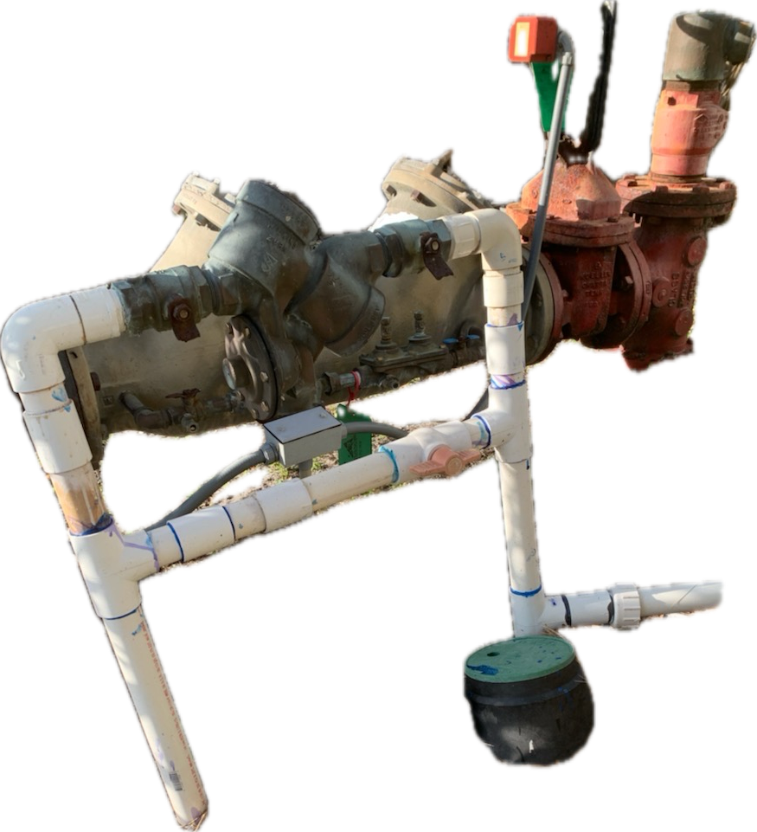
Reported Cross Connections
Part V and VI of FAC62-555.900 form 13
Number of prohibited AND inadequate protection
Total of 1318 discovered (based on latest)
1180 services Inadequately protected
138 Prohibited Cross Connections

Slide 26
THE most common occurring cross connection
Many Utilities do not inspect or protect homes which irrigation with aux yet…
106 of the 138 discovered cross connections were with irrigation systems
14 irrigation “wells” connected to home or business
86 reclaimed water cross connections to homes

Slide 27
Other Less Common Cross Connections
4 discovered underground tees
15 “jumper” or “bypass”
51 illegal connections to hydrant for construction
24 “commercial” related cross connections

Slide 28
Key Takeaways​
Commercial Meters should have 90%+
Need more control of irrigation systems
Utilities with high use of Aux water need to pay attention to Residential protection
Only 17% of Florida Utilities are reporting full compliance with FAC 62-555.360
≤ 90% commercial tested
≤ 40% residential tested
all irrigation meters protected
legal DuC policy
Florida Cross Connection Score: F

Slide 29
Call to action
Florida Must Do Backflow BETTER!
Utilities have primary responsibility
FDEP has the overall responsibility
​

Slide 30
State of The State A Survey of Florida CCC Programs
Bradley Hasseler
02/21/2024

