Slide 1
Why We Do Surveys
2024 UF TREEO Conference
Presented By: Steve Fox, SC DHEC

Slide 2
Types of Facilities Connected
Large Hospitals/Clinics
Hangar's w/Fabrication Equipment
Warehouses
Construction/Facility Maint. Shops
Laboratory Buildings
Dental Facilities
Munition Storage ( Nuclear & Non-Nuclear Storage)
Auto Centers
Fuel Farms
Office/Administration Support
Fitness Centers/Ball Fields
Fire Dept
Water Plant/Wastewater Plant
Fire System Distribution Facilities
Dining Facilities/cafeteria
Retail Stores/Grocery/Food Court
Dry Cleaners
Dormitories
Medical Examiner/Mortuary Affaires
Basically, a Small City

Slide 3

How do we get Flo??
Flow
Pressure??
Partial Credit
We Need a DIFFERNCE in PRESSURE
Notes:
The 2 types of backflow are: BACKSIPHONAGE & BACKPRESSURE

Slide 4
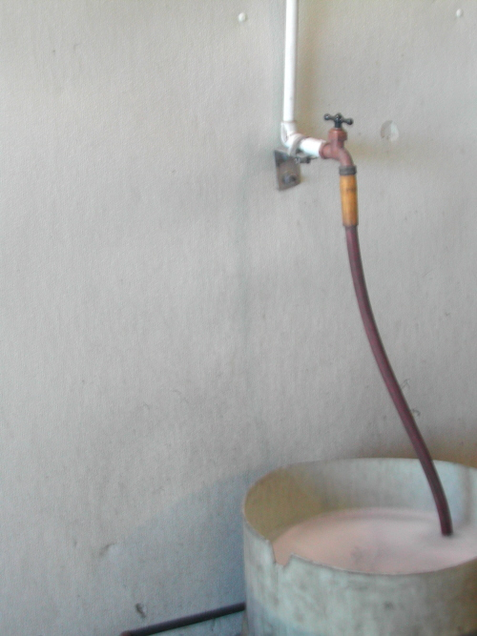
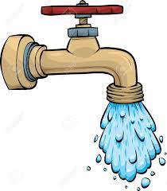

What do we need to create flow??
We need a Pathway/Link and a difference in Pressure
50 psi
30 psi
High pressure always goes to low pressure
Notes:
The 2 types of backflow are: BACKSIPHONAGE & BACKPRESSURE

Slide 5
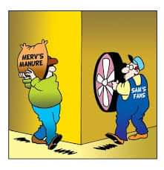
What happens when we have a Backflow Event???

Slide 6
QUICK REVIEW –
Codes, Regulations, Standards used for survey

Slide 7
Survey Preparation/Considerations
Codes and Regulations – Must know relevant codes. This case study was under IPC & UPC…
Containment vs. Isolation? or a combination
Field Forms/Data Entry Process (i.e., how will you document field data?)
Ladders, equipment (considerations for inspecting pipe above tile)!

Slide 8
Survey Preparation/Considerations
5. Site Water Main and Architectural Drawings – Showing All Areas, plumbing drawings, etc.
Meet with Personnel Familiar w/ Water Systems
PPE (eye protection, hearing protection..etc.)
Clarify Accessibility ( entree, master keys, permission, escorts, Security Concerns, etc.)
Communication – Escorts, Facility Managers, Facility occupants

Slide 9
Backflow Preventer–Selection Criteria
Evaluate Hazard Level of substance that could backflow – High/Health Hazard or Low Hazard/Non-health Hazard?
Could backflow occur due to Backpressure, Backsiphonage, or BOTH?
Is “Continuous Pressure” resulting from a downstream shutoff/control valve possible (Y/N)?
Notes:
When selecting the correct backflow preventer to control a cross connection, there are 3 main questions to review. By answering these 3 questions, the proper selection of the appropriate backflow preventer can be obtained for any cross connection. These questions will be reviewed in more detail throughout this training course.

Slide 10
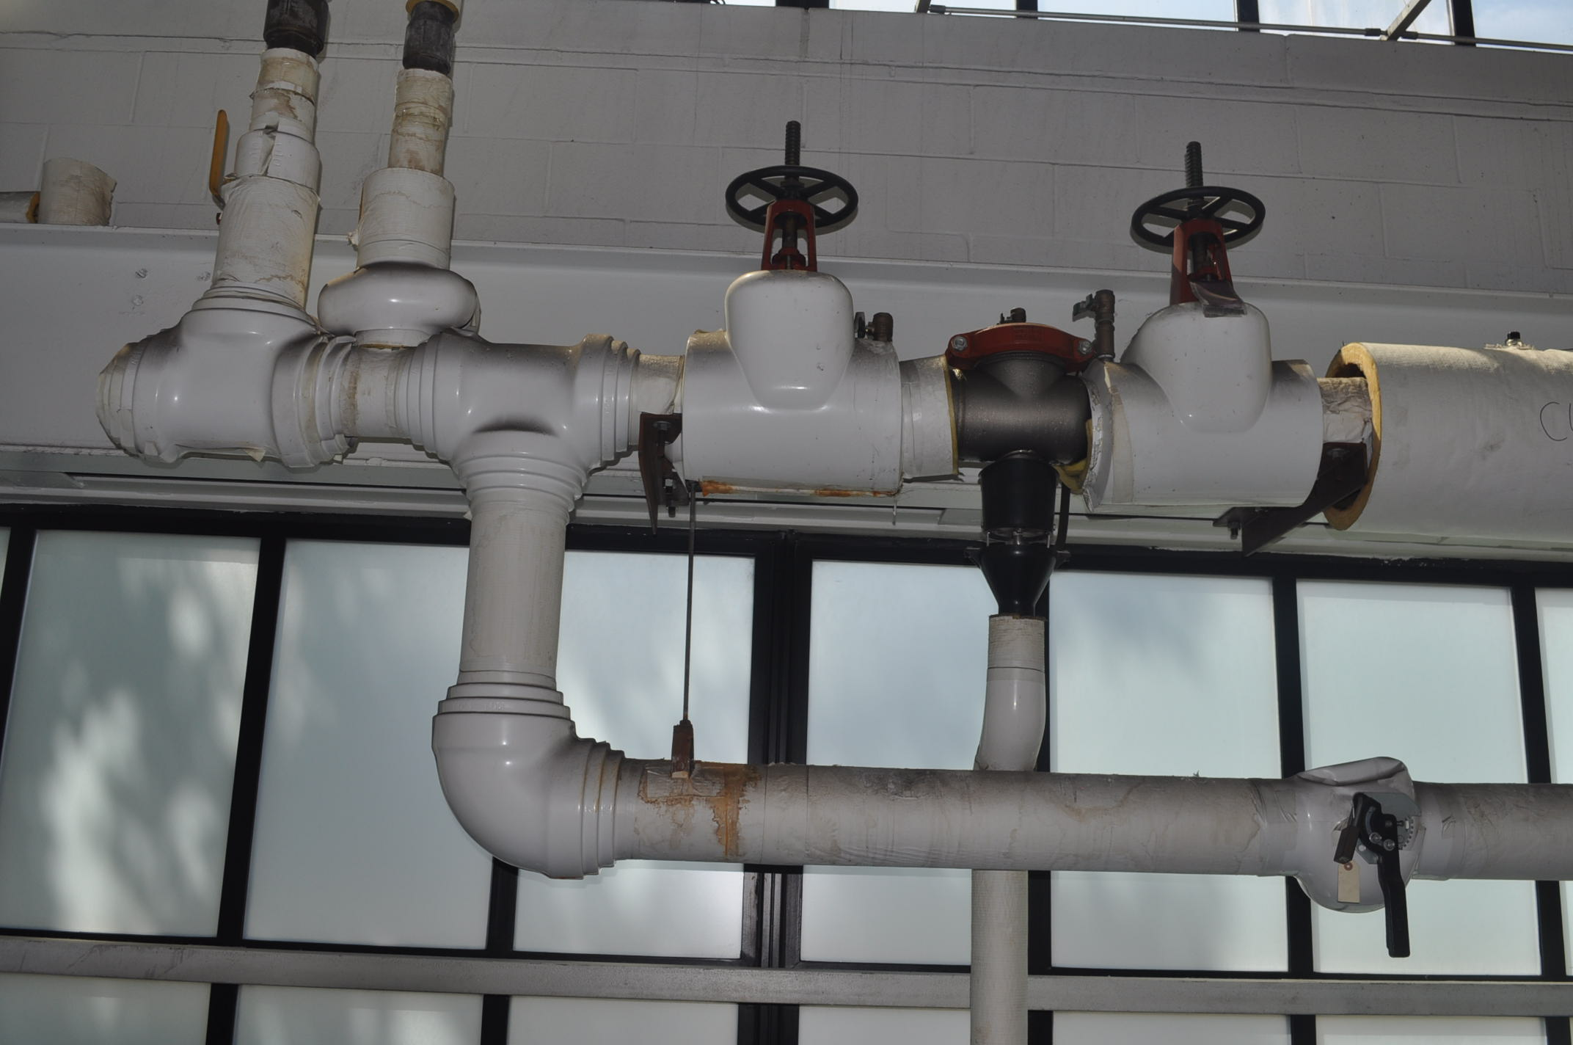
FACILITY CONTAINMENT EVALUATION
RPBP
City Water Flow
Unprotected Bypass

Slide 11
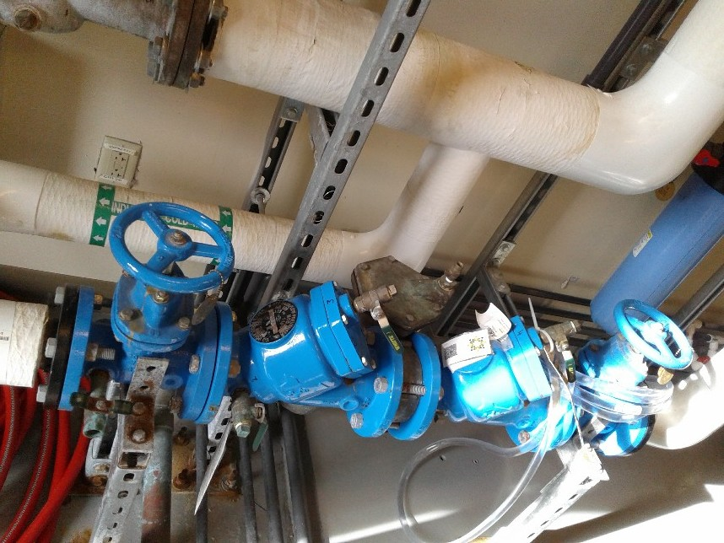
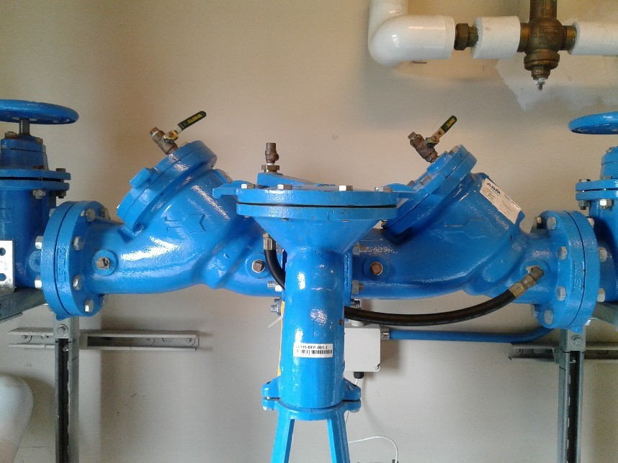
Service Connection/Medical Examiners

Slide 12
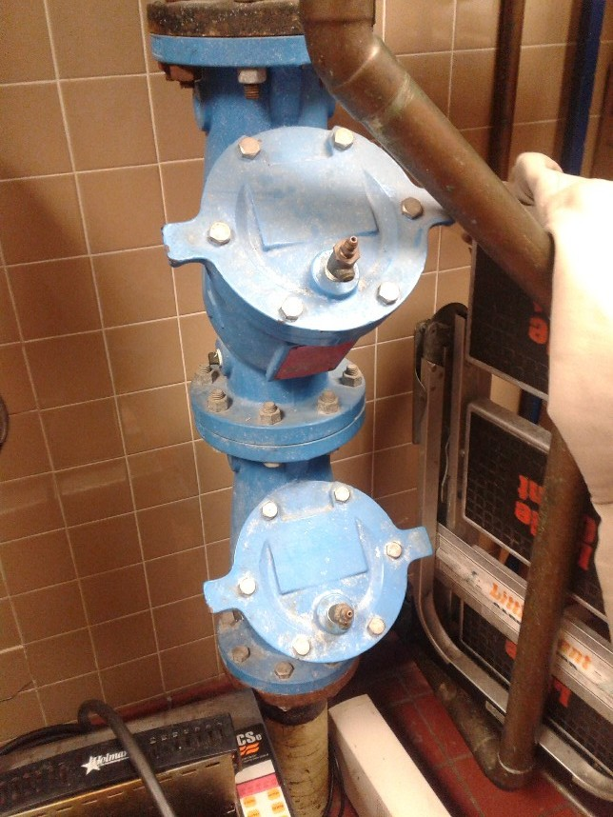
Fast Food Service Connection.. Is this correct?

Slide 13
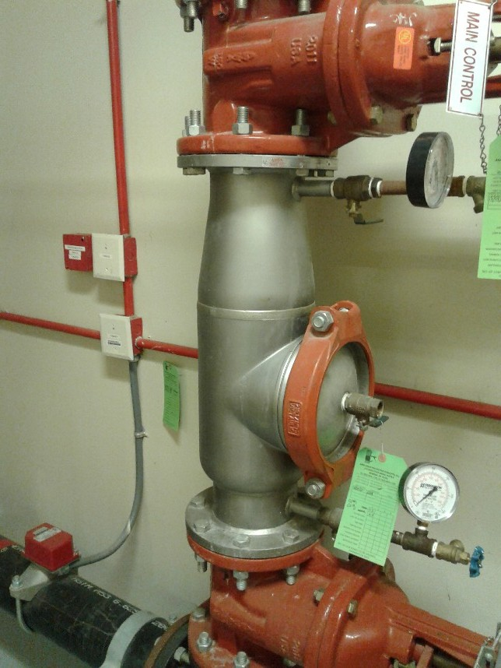
Fire Service Connection

Slide 14
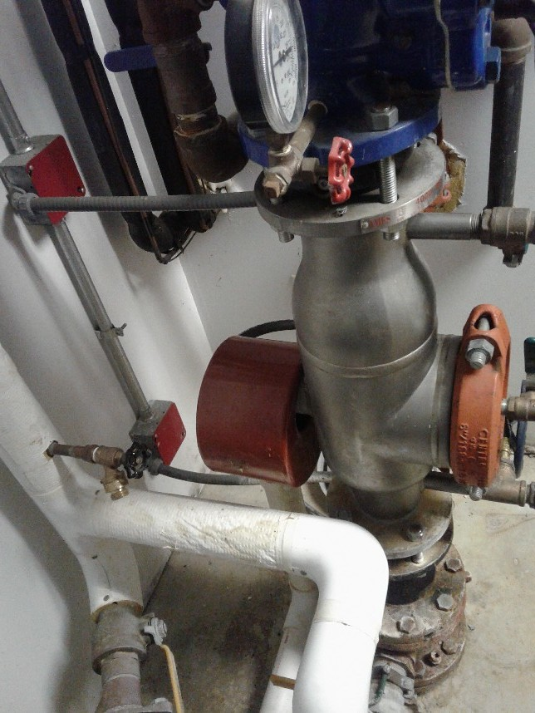
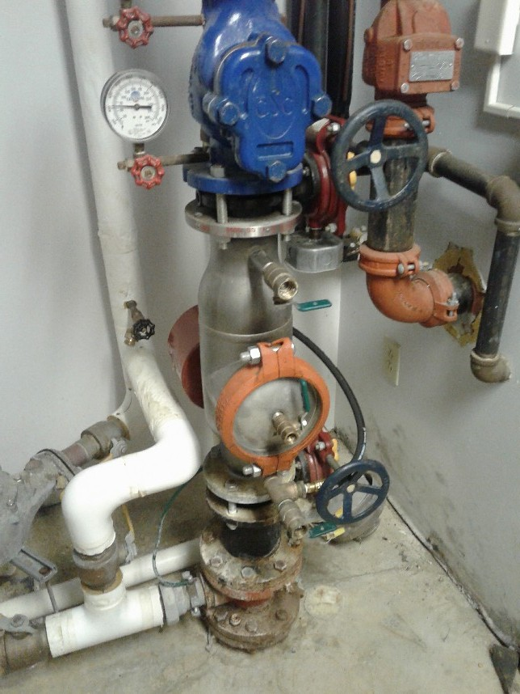
Fire Service Connection, Is this Correct??

Slide 15
CROSS CONNECTION SURVEY
ISOLATION EVALUATION

Slide 16
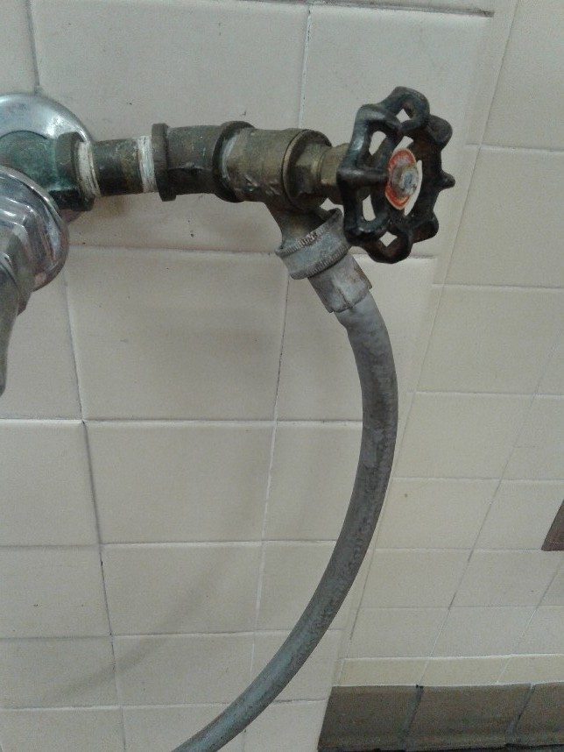
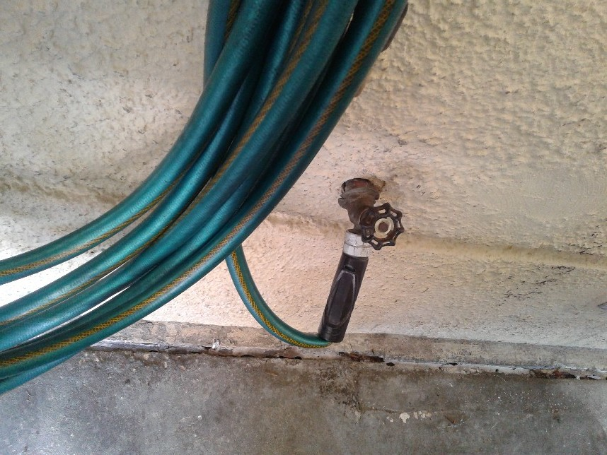
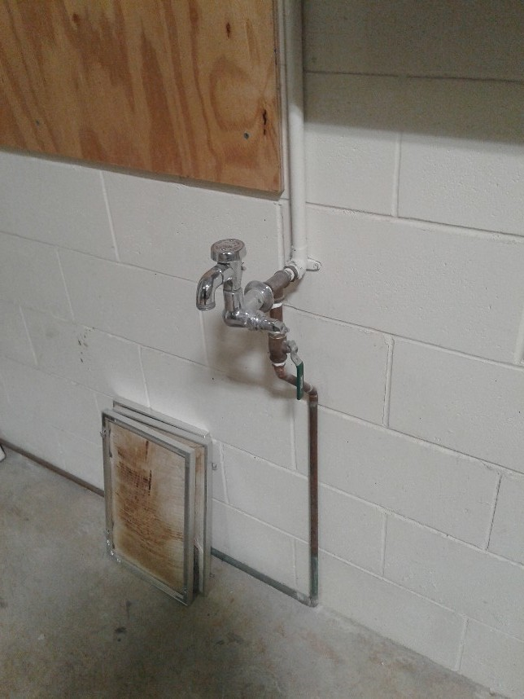
Hose Bibbs/Faucets

Slide 17
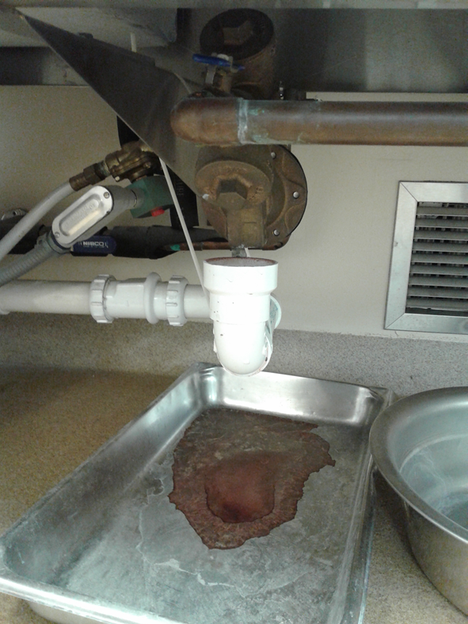
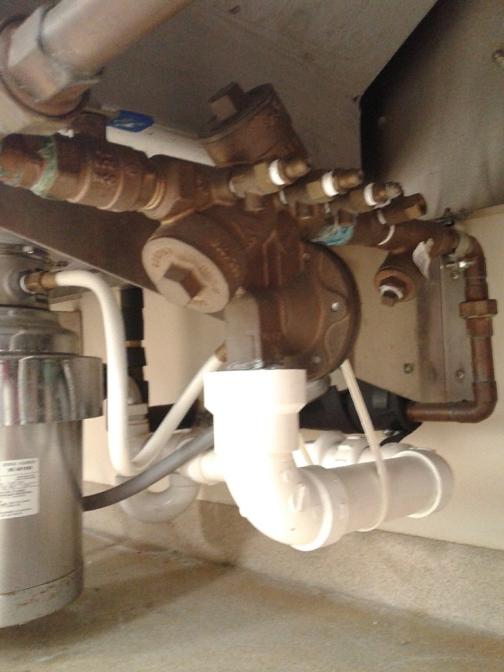
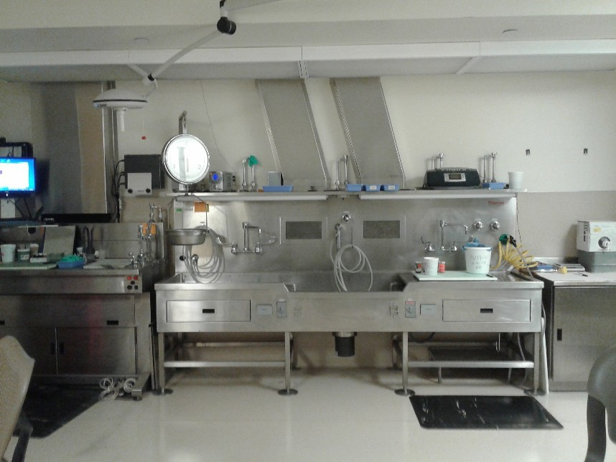
Internal: Autopsy/Embalming Station Supply
RPBP in main supply

Slide 18
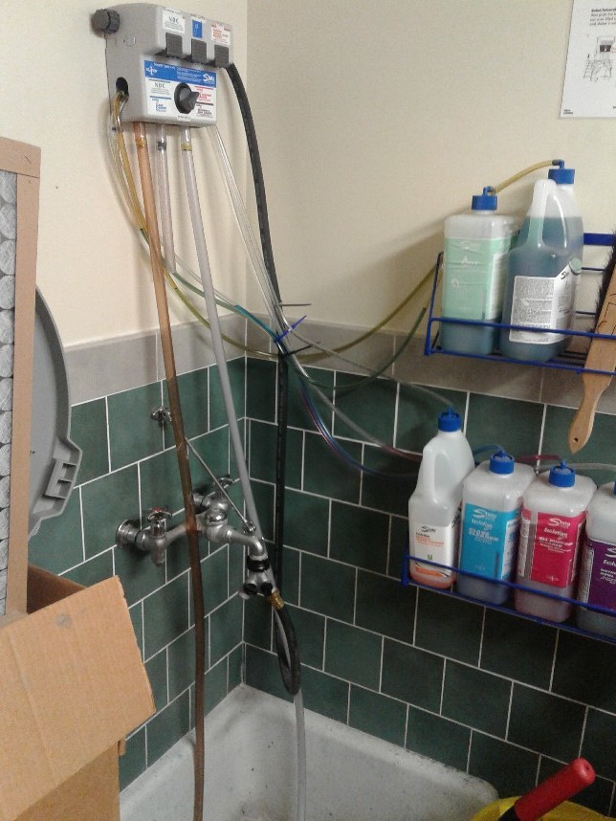
Janitor Closet
Potable Water Supply
Connection to Chemicals w/Valves downstream of AVB & Backpressure from elivation
Wye Connection with
Shut-off Valves

Slide 19
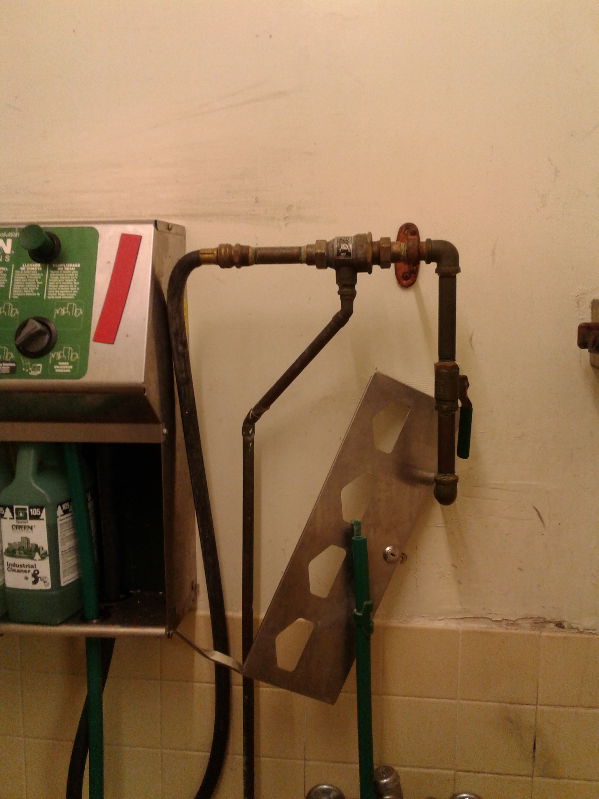
Janitor Closet
Correct Device??

Slide 20
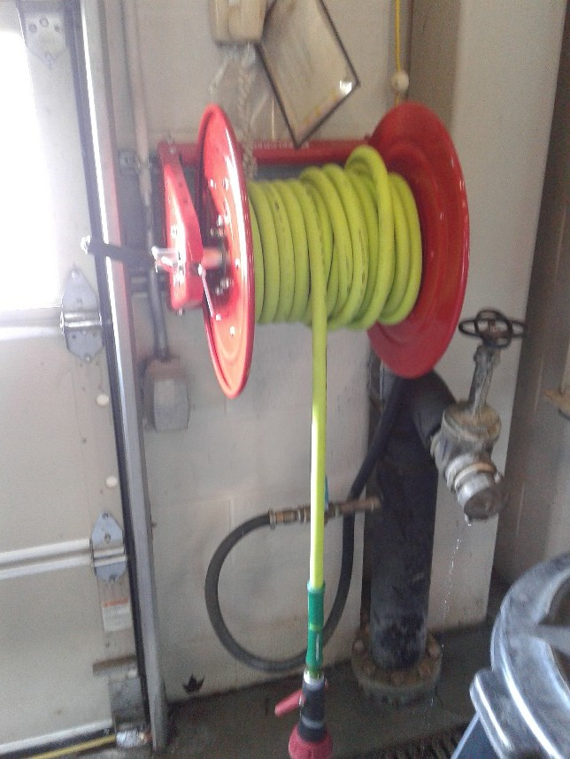
Fire Dept. Hose Reel & Fill Station

Slide 21
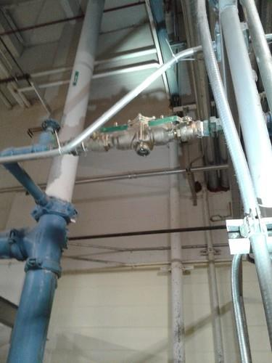
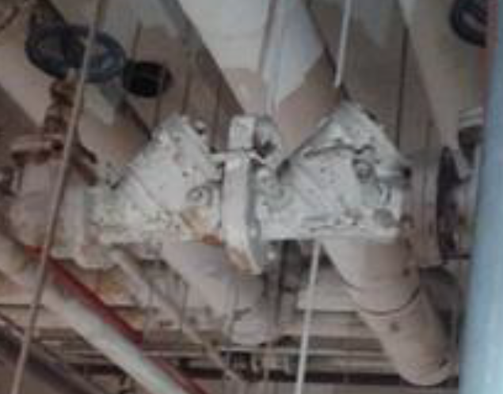
Chiller/Boiler Make-up

Slide 22
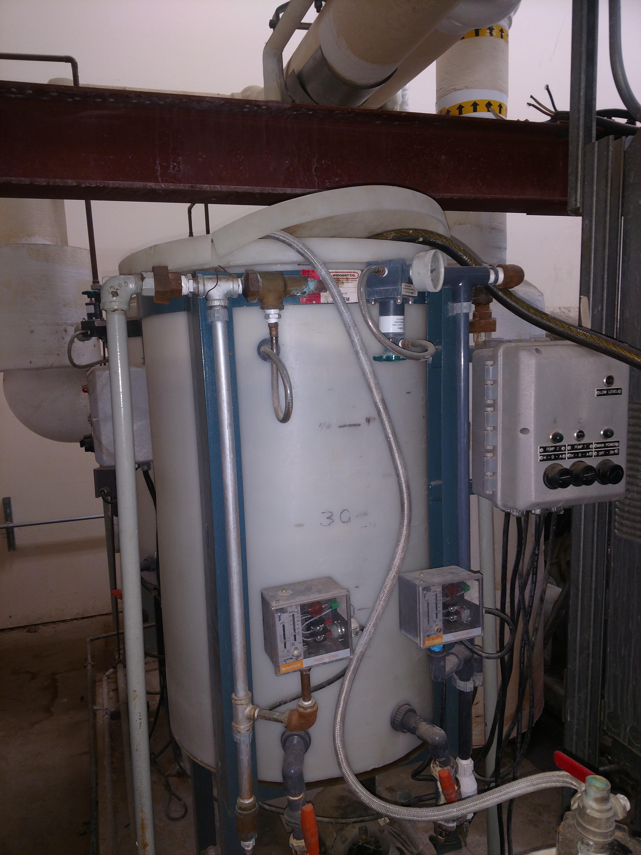
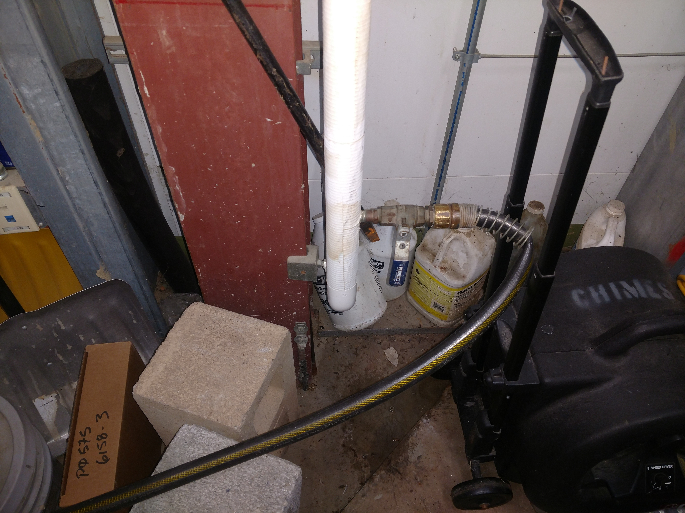
Chiller/Boiler Make-up

Slide 23
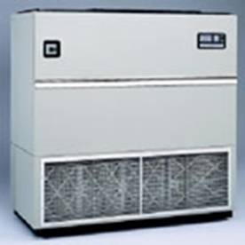
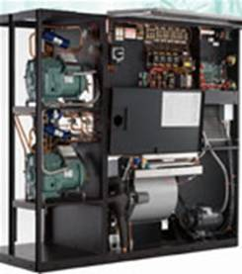
Other Cooling Systems
“Liebert Units” - filled cooling system. Coolant is circulated elsewhere to an air-cooled heat exchanger or chiller unit.
Small water line may enter Liebert Unit to minimize static electricity/arching that could damage sensitive equipment. Air gap required in supply to discharge tray – controlled by solenoid valve.

Slide 24
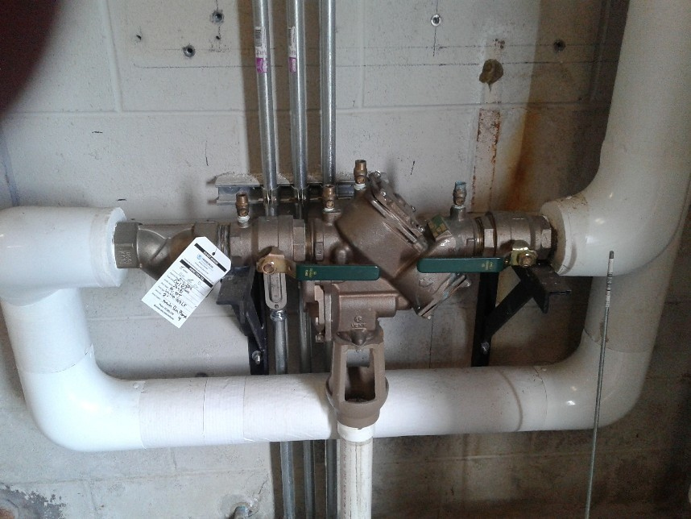
Liebert Unit Supply…

Slide 25
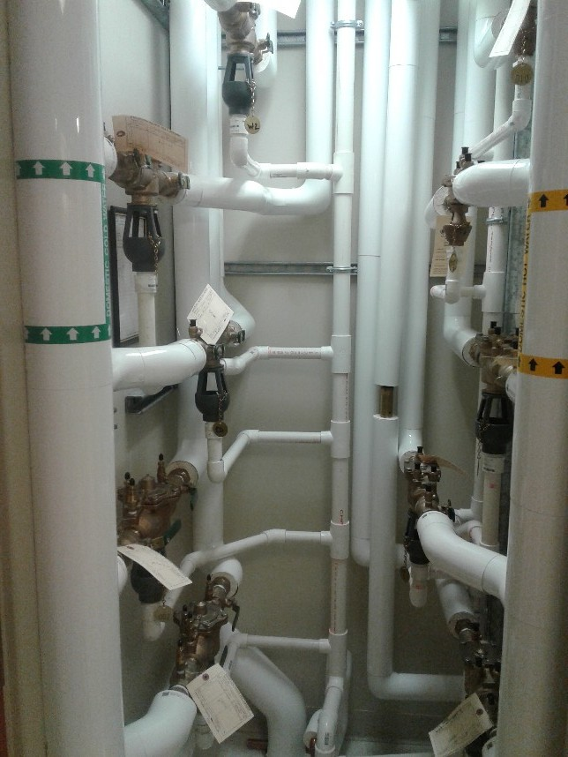
Dental Clinic Exam/Lab Room Supply
Could use some labeling

Slide 26
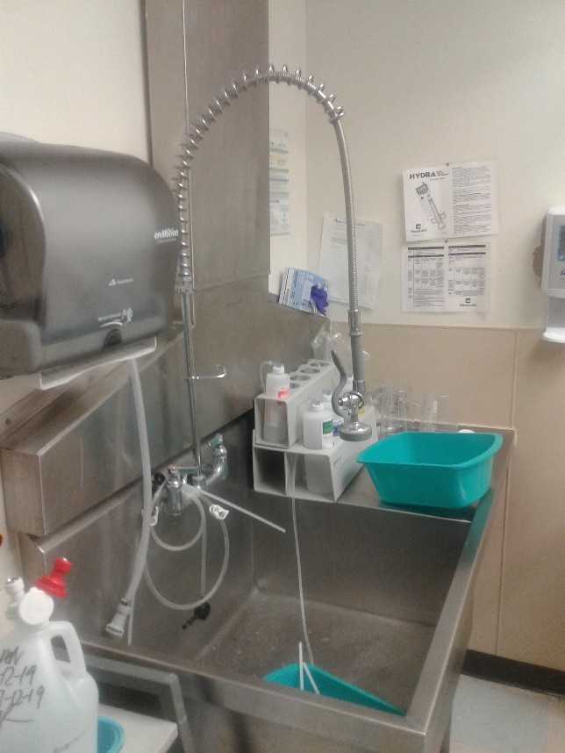
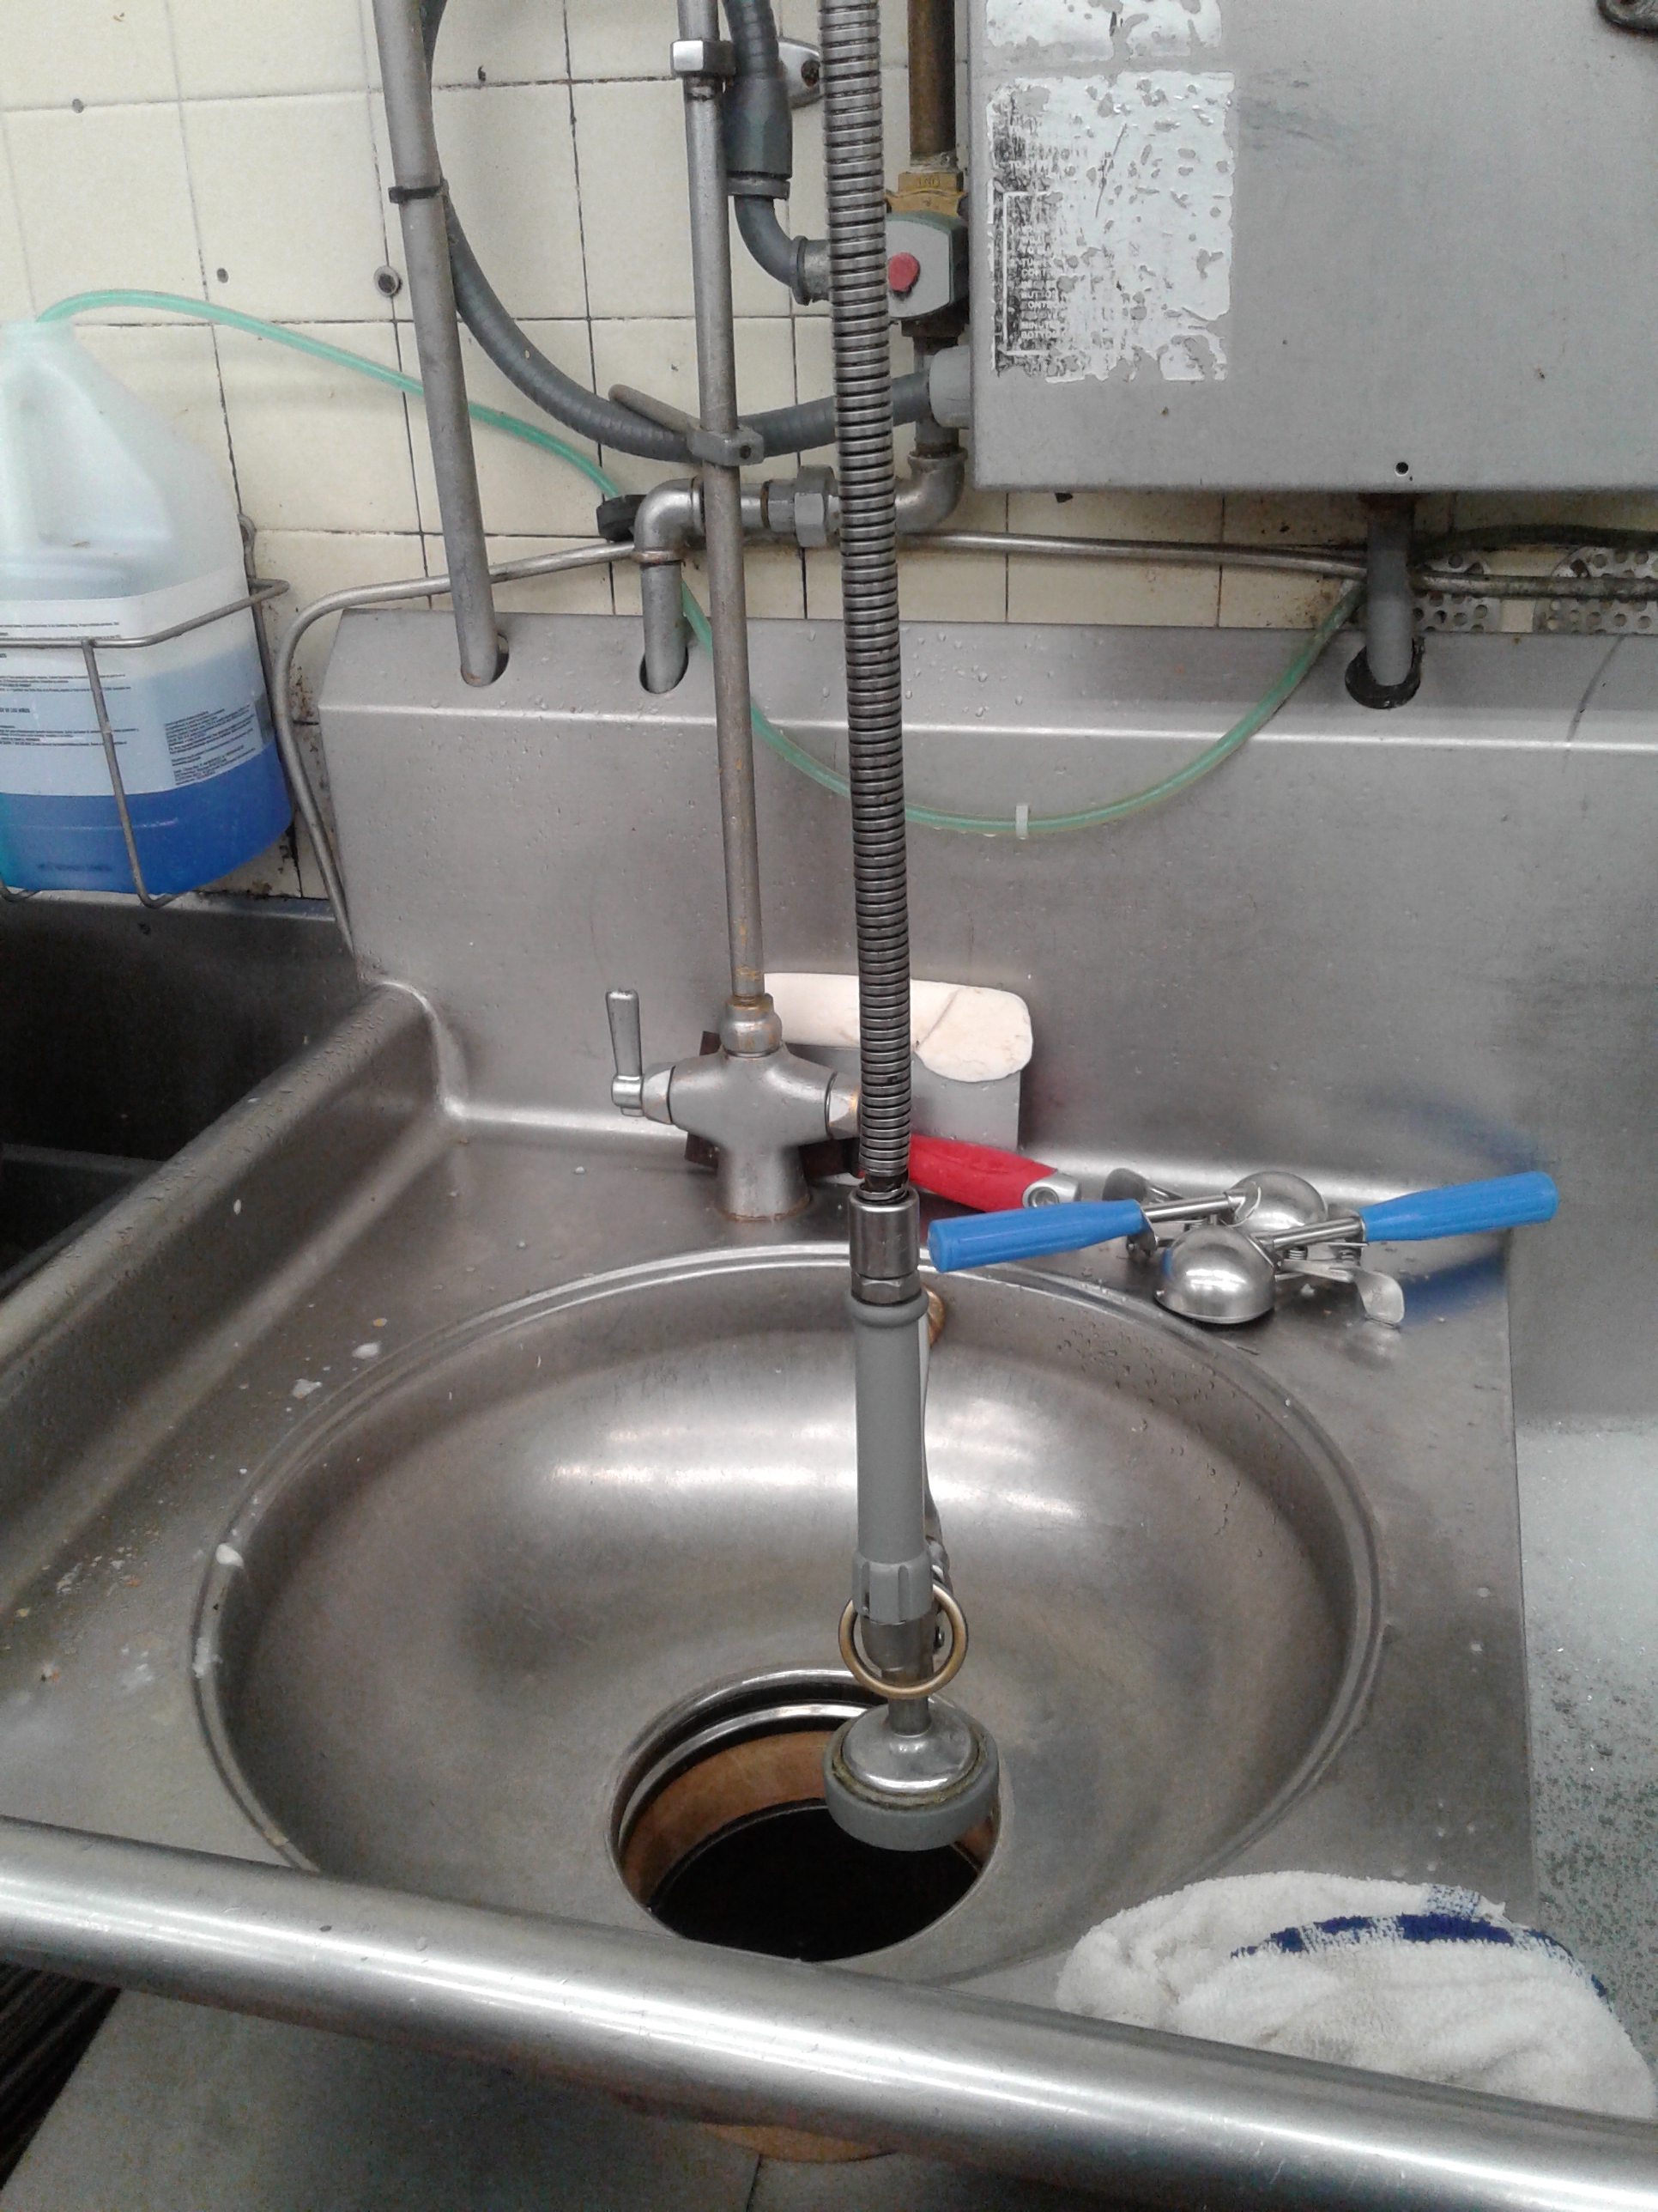
Sinks/Spray Stations

Slide 27
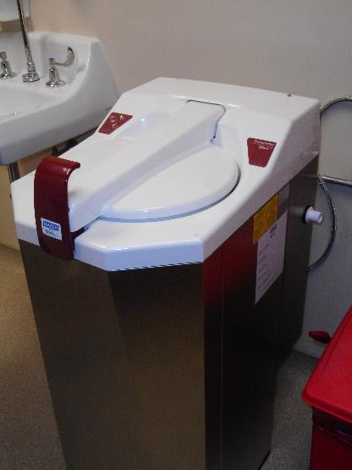
“Macerator”
Disposal of bedpan pulp materials and waste
Machine pulverizes materials with addition of water to facilitate decomposition and drainage
Water typically flows from top of lid
RPBP may be recommended – water supply is typically threaded hose connection from behind unit

Slide 28
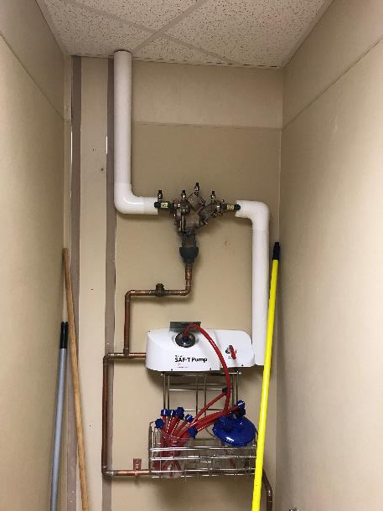
“SAF T” Pumps
Disposal of infectious liquid medical waste
Potable water flows through venturi – aspirating dangerous fluids to waste stream (High Hazard!)
Reduced pressure principle backflow prevention assembly
Commonly found - Operating Room areas
Must review drainage of RPBP

Slide 29
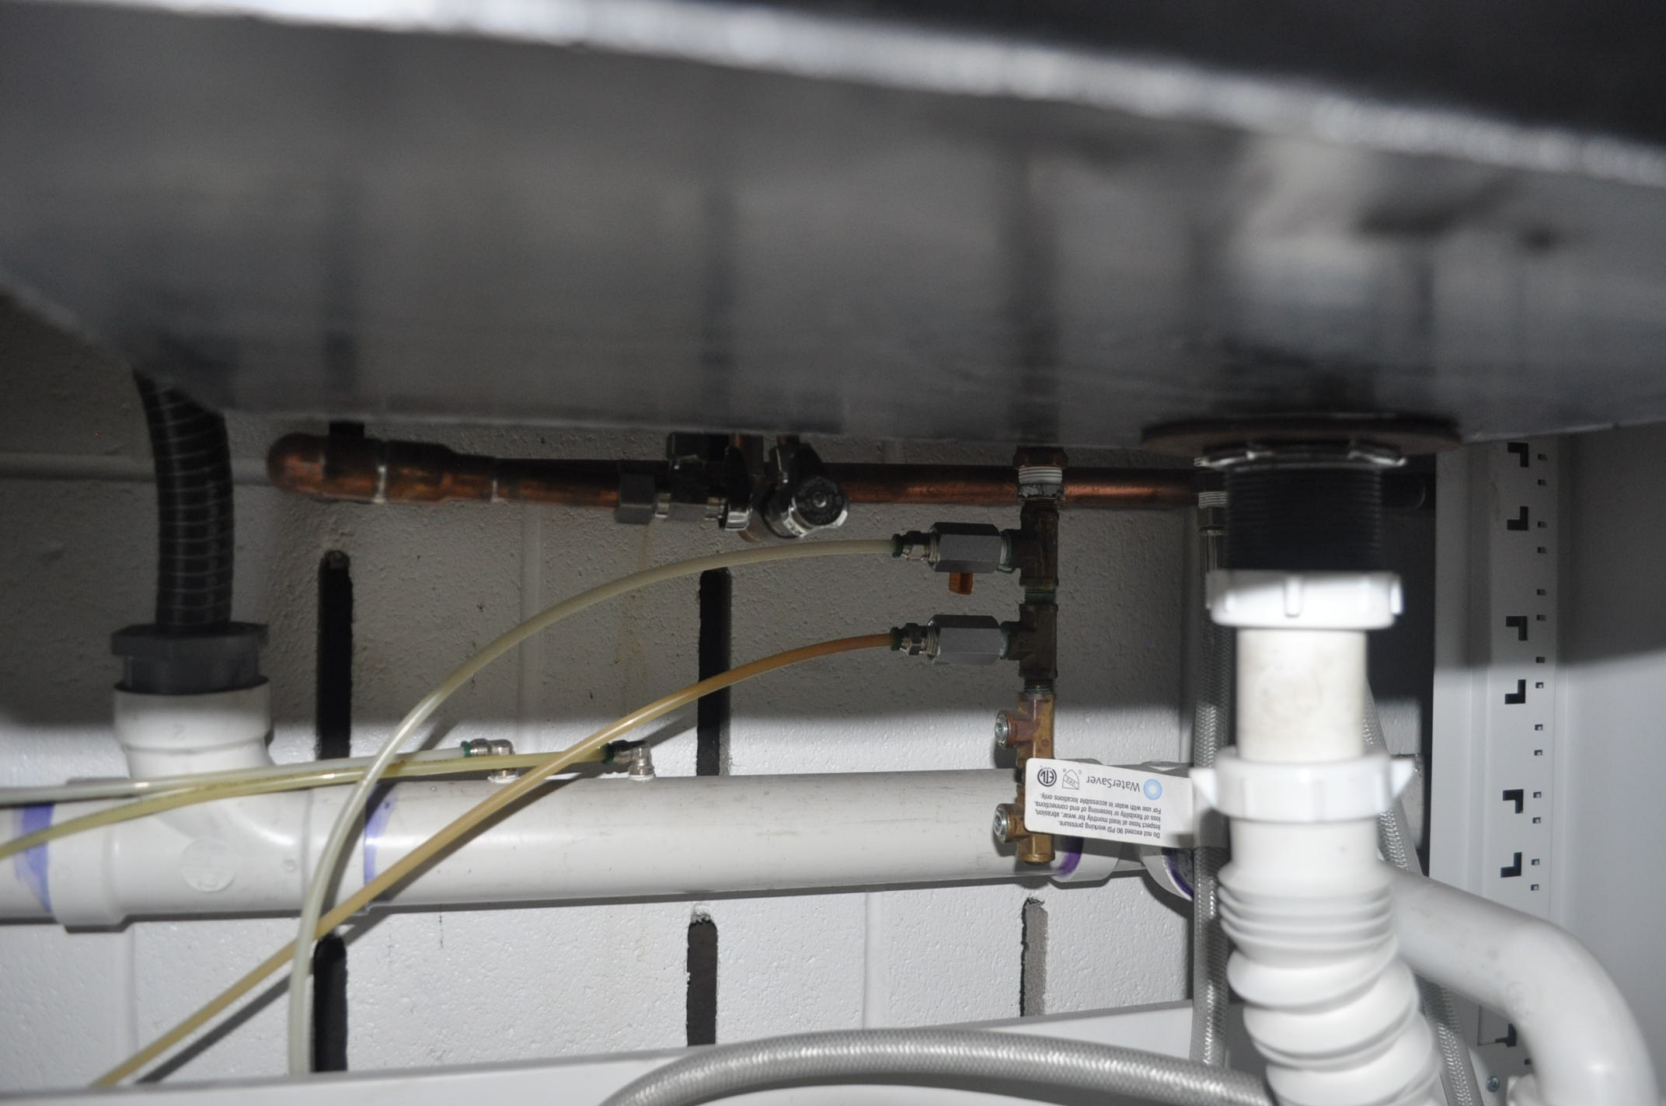
Water Cooling Line-Lab Equipment
¼” Potable Water Supply to Lab Equipment for Cooling
¼” Potable Water From Lab Equipment to Drain-
No Air Gap
Notes:
This photo shows a quarter inch potable water supply line flowing to a piece of lab equipment for cooling. Once the water line cools the equipment, it flows into the sewer drain and is directly connected as shown. There is no air gap on the drain. If the potable water supply experiences a vacuum, water from the sewer drain may backsiphon into the water supply. An air gap must be fabricated to control the cross connection.

Slide 30
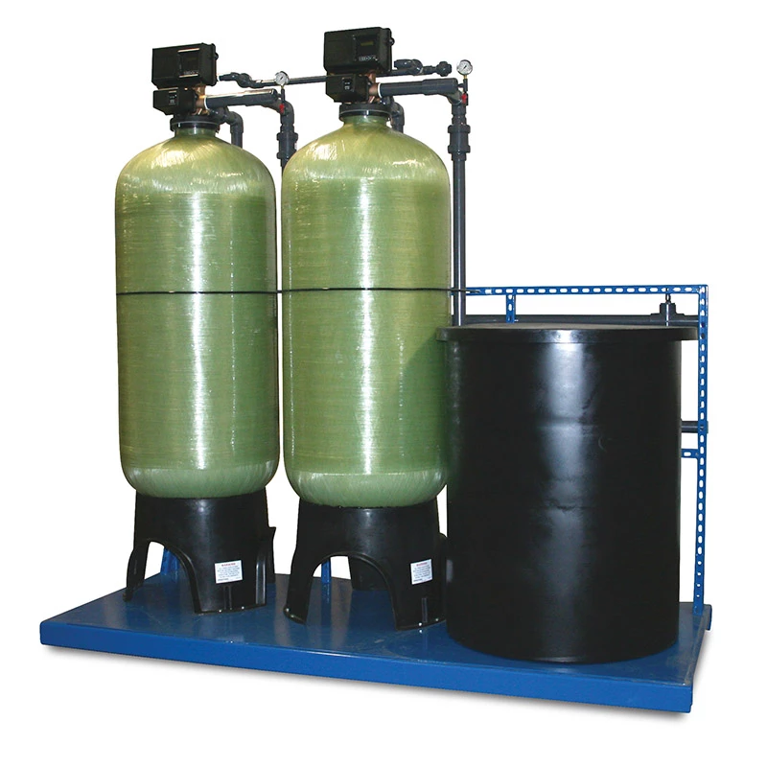
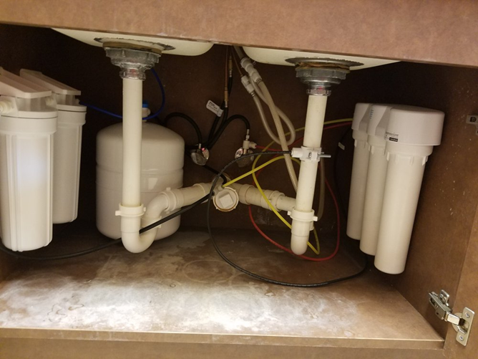
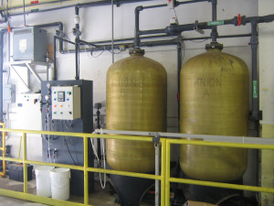
RO/Deionized/Softener Water Systems

Slide 31
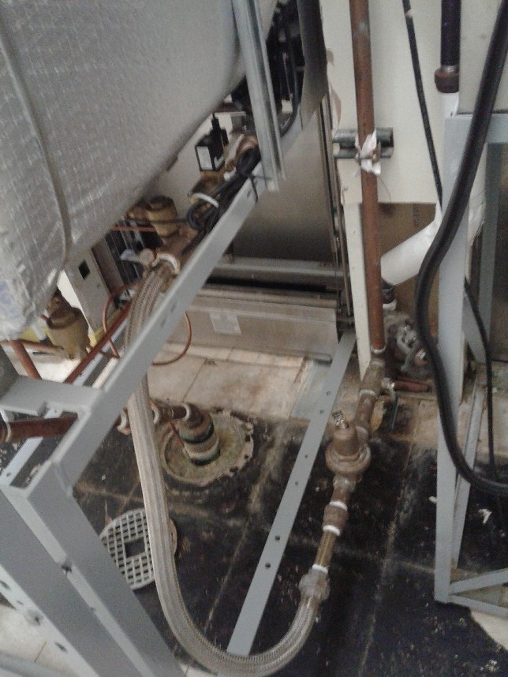
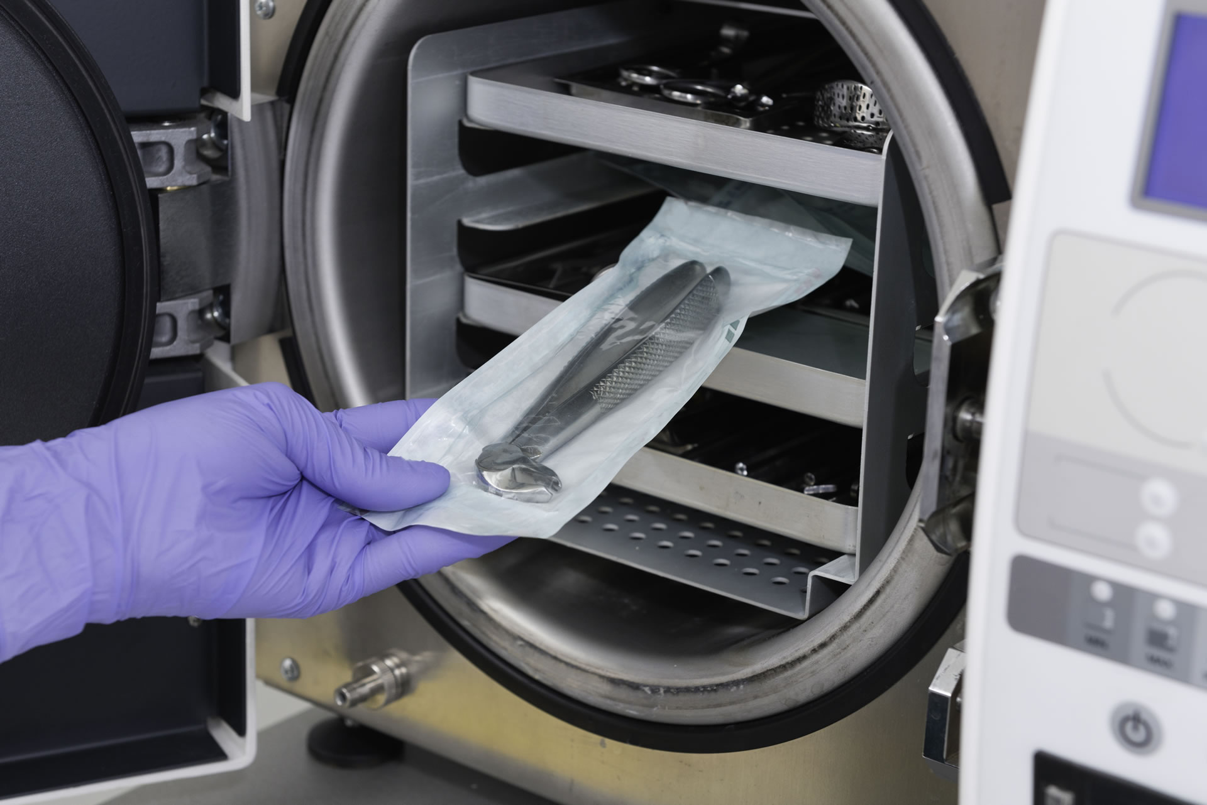
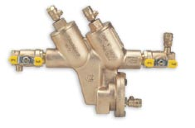
Autoclave/Sterilizer Processing

Slide 32
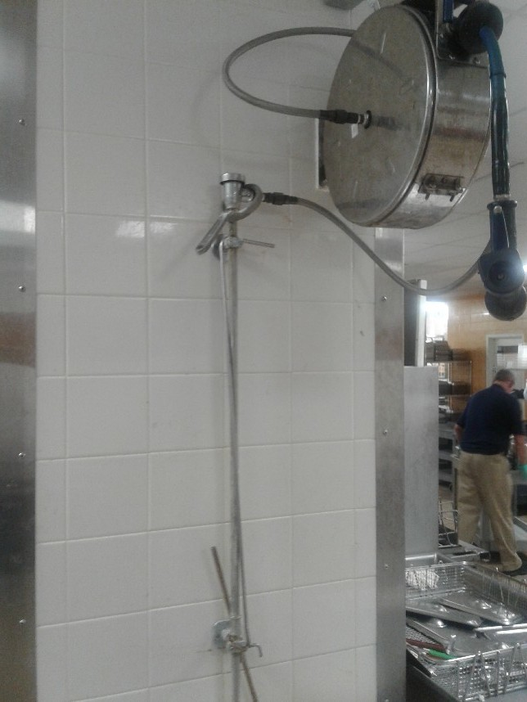
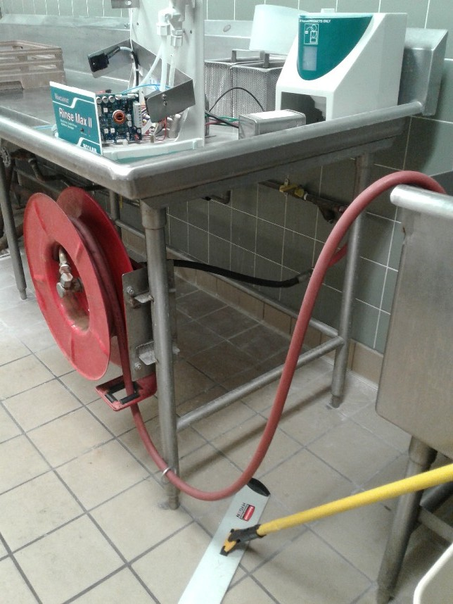
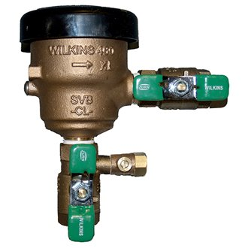
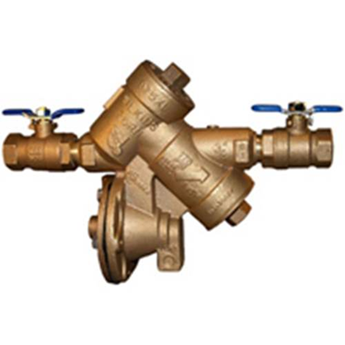
Hose Reels

Slide 33
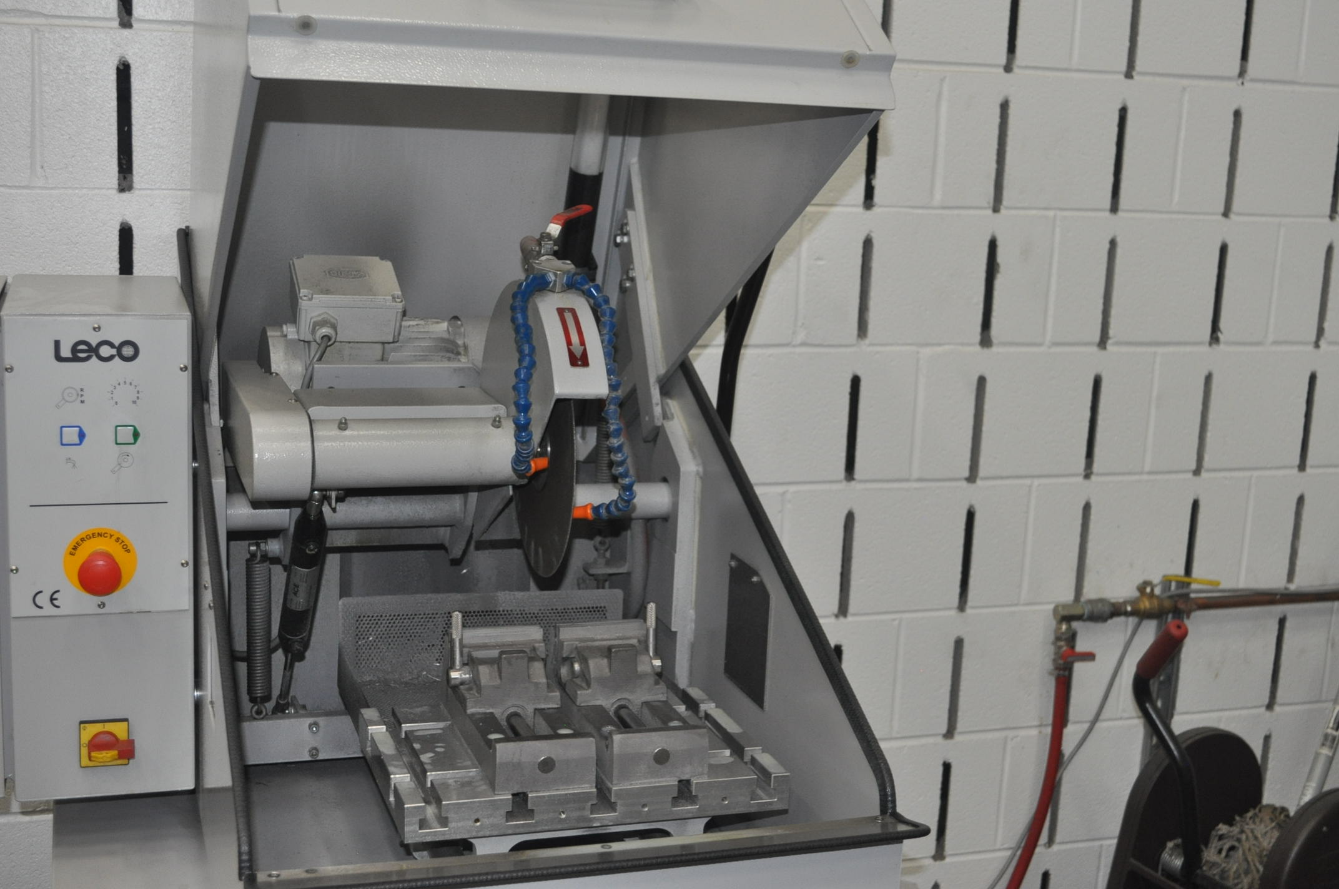
Cutting Machine
Water Discharge
Potable Water Supply
High or Low Hazard? High
Backsiphonage and/or Backpressure? Backsiphonage
Continuous Pressure? Yes
Protect Supply with SVB,PVB, or RPBP!
Notes:
This photo shows a quarter inch potable water supply line flowing to a piece of lab equipment for cooling. Once the water line cools the equipment, it flows into the sewer drain and is directly connected as shown. There is no air gap on the drain. If the potable water supply experiences a vacuum, water from the sewer drain may back-siphon into the water supply. An air gap must be fabricated to control the cross connection.

Slide 34
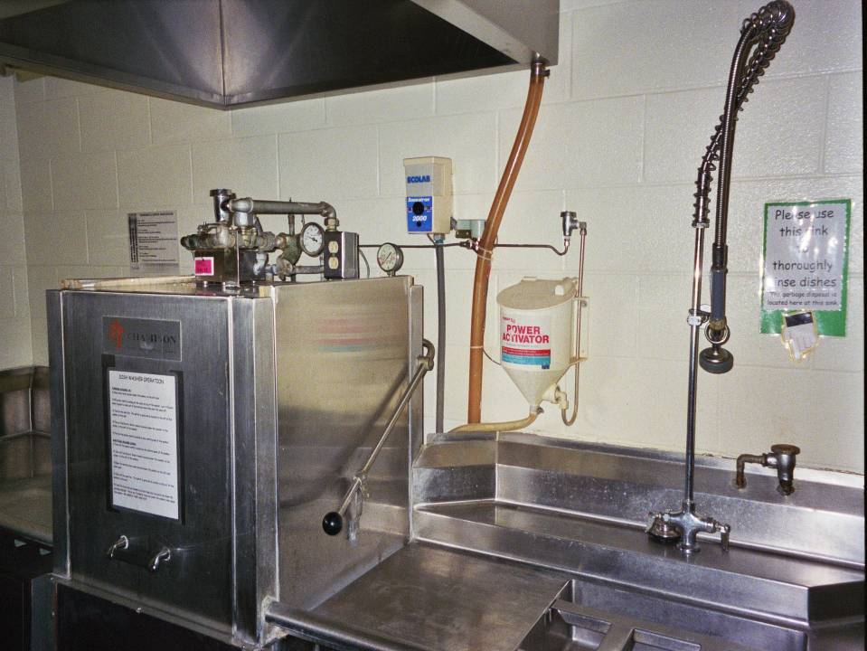
Soap Dispenser AVB
Dishwasher AVB
Hand Sprayer
Garbage Disposal AVB
Notes:
What can you identify in this picture?
Dishwasher with AVB
Things to look for:
AVB at least 6” above down steam uses
No valves down stream
AVB installed in the vertical position
Soap Dispenser
AVB at least 6” above down steam uses
No valves down stream
AVB installed in the vertical position
Hand Sprayer
Remove hand sprayer from the hook and verify retention spring will maintain hand sprayer at least 1” above compartment sink flood level rim
Garbage Disposal
AVB at least 6” above down steam uses
AVB installed in the vertical position
No valves down stream

Slide 35
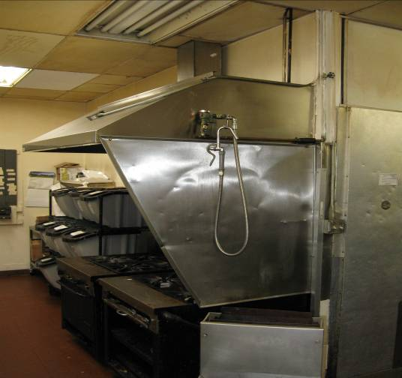
Pot Filler Hose With Valve – PVB/SVB

Slide 36
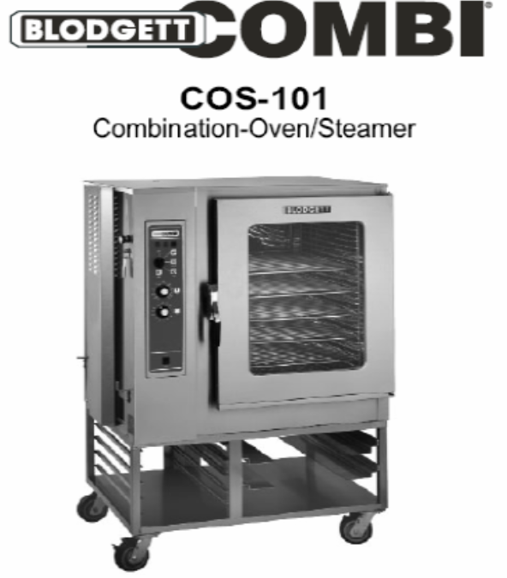
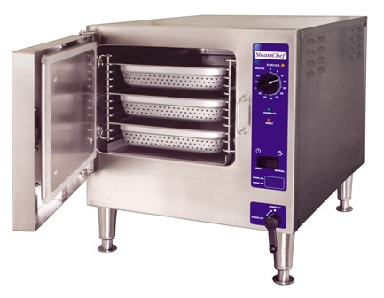
Steamer & Combi-Style Ovens - VDCV
Used to reheat or warm food
May have both a hot and cold-water supply
May contain additives to feed water
Any steamer additives should be approved by USDA, FDA, or DOH
Subject to backpressure due to thermal expansion

Slide 37
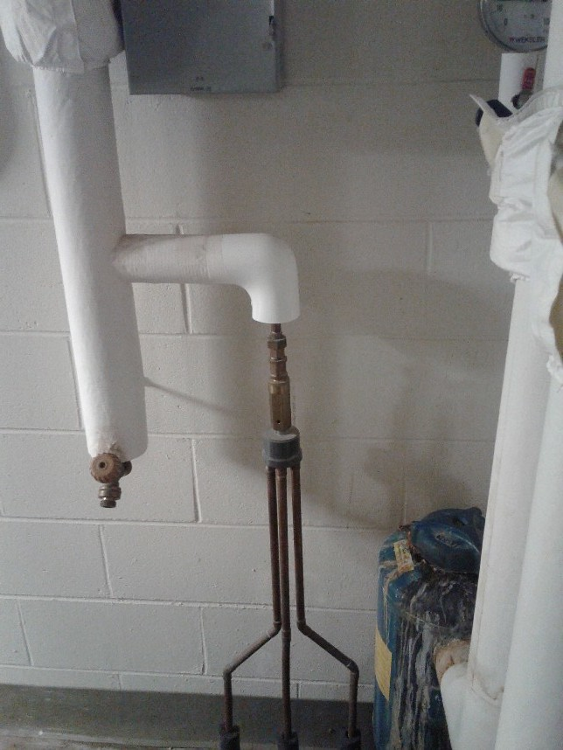
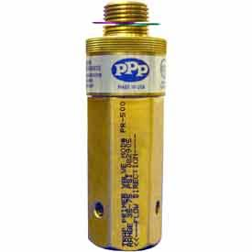
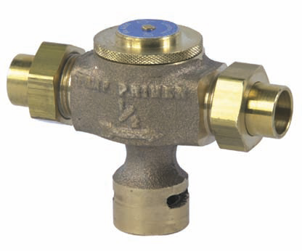
Trap Seal Primer Valves – Water Supply Fed

Slide 38

Car Wash

Slide 39

Decorative Fountains/Water Walls
High Hazard Cross-Connection!
Chemical treatment, exposure, bacterial growth, etc.
Many hospitals are decommissioning due to Legionella concerns…

Slide 40

Decorative Fountains – Typical System Makeup

Slide 41

Irrigation Supply
IPC Section 608 – Lawn Irrigation shall be protected using an AVB, PVB or RP…
They must consider this to be a High Hazard System
IPC Section 608 - Valves & outlets below grade: “ Potable outlets and combination stop & wastes valves SHALL NOT be installed underground or below grade.”

Slide 42

Yard Hydrants…
“Potable water outlets and combination stop-and-waste valves shall not be installed underground or below grade. Freezeproof yard hydrants that drain the riser into the ground are consid­ered to be stop-and-waste valves.”
Exception: Freezeproof yard hydrants that drain the riser into the ground shall be permitted to be installed, provided that the potable water supply to such hydrants is protected upstream of the hydrants and the hydrants are permanently identified as non-potable outlets by approved signage that reads as follows: "Caution, Non-potable Water. Do Not Drink."

Slide 43

Bulk Water Safety

Slide 44


Slide 45
Report Out Information
Inventory of all backflow prevention assemblies, devices and methods
Itemized list of recommendations/requirements based upon survey information – be specific in terms of location, system, etc.
Service connection assessment
Internal Program Compliance, Local/State or OSHA Compliance
What do we have, and what do we need to do?

Slide 46
Survey Recommendations/Tips
Ask Questions – How do you use this, or do you still use this? What does this hose supply?, etc.
Black Box Evaluation – Cross Connections:
  1. Where/how does the water go in?
  2. What does the water do when inside?
  3. Does water come out, and where/how?
Be an “educator”, not just an “enforcer”

Slide 47
Survey Recommendations/Tips
Don’t Rush – Take your time, ask questions, attention to detail, be a detective
Know your Codes and Regulations:
  1. Have Plumbing Code readily available
  2. List of backflow preventer approvals
  3. Local ordinance, state reg’s, etc.
Always assume client does not know what you’re talking about – education is key

Slide 48



Slide 49

QUESTIONS?
Steve Fox
SC DHEC
Cross-Connection Control Program Coordinator
2600 Bull Street
Columbia, SC 20201
(Office)803-898-4426
foxsc@dhec.sc.gov

