Slide 1
Fire Pumps & Backflow Assembly Installation Concerns
Instructors:
John August Denhardt, P.E., FSFPE

Slide 2
DISCLAIMER
This seminar and its content is not a formal interpretation issued pursuant to NFPA regulations. Any opinion expressed is the personal opinion of the author and presenter and does not necessarily present the official position of the NFPA and its Technical Committees.

Slide 3
John August Denhardt, P.E., FSFPE
American Fire Sprinkler Association
John August Denhardt is Vice President of Engineering and Technical Services. He is responsible for strengthening AFSA’s engineering and technical approaches to meeting member, industry and operational priorities, with an emphasis on service, quality, and integrity. Denhardt is a Professional Engineer (P.E.) registered in the District of Columbia as well as the states of Delaware, Maryland, Pennsylvania, and Virginia. In addition to his P.E., he is a NICET Level III in Water-Based System Layout and Inspection & Testing of Water-Based Systems. A native of Maryland, Denhardt holds a Bachelor of Science degree in Fire Protection Engineering from the University of Maryland in College Park.
Prior to accepting this position, Denhardt was employed by Strickland Fire Protection in Forestville, Maryland since 1994, overseeing large scale projects and assisting with design and installation technical issues. He has served as an AFSA instructor, volunteered as a subject matter expert assisting with AFSA training updates, represented the Association on various technical committees, and authored numerous articles in the Association's flagship publication Sprinkler Age. In 2010, he was named a Fellow in the Society of Fire Protection Engineers.
jdenhardt@firesprinkler.org | P: 214-349-5965 | American Fire Sprinkler Association

Slide 4
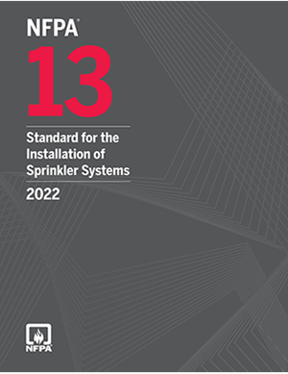
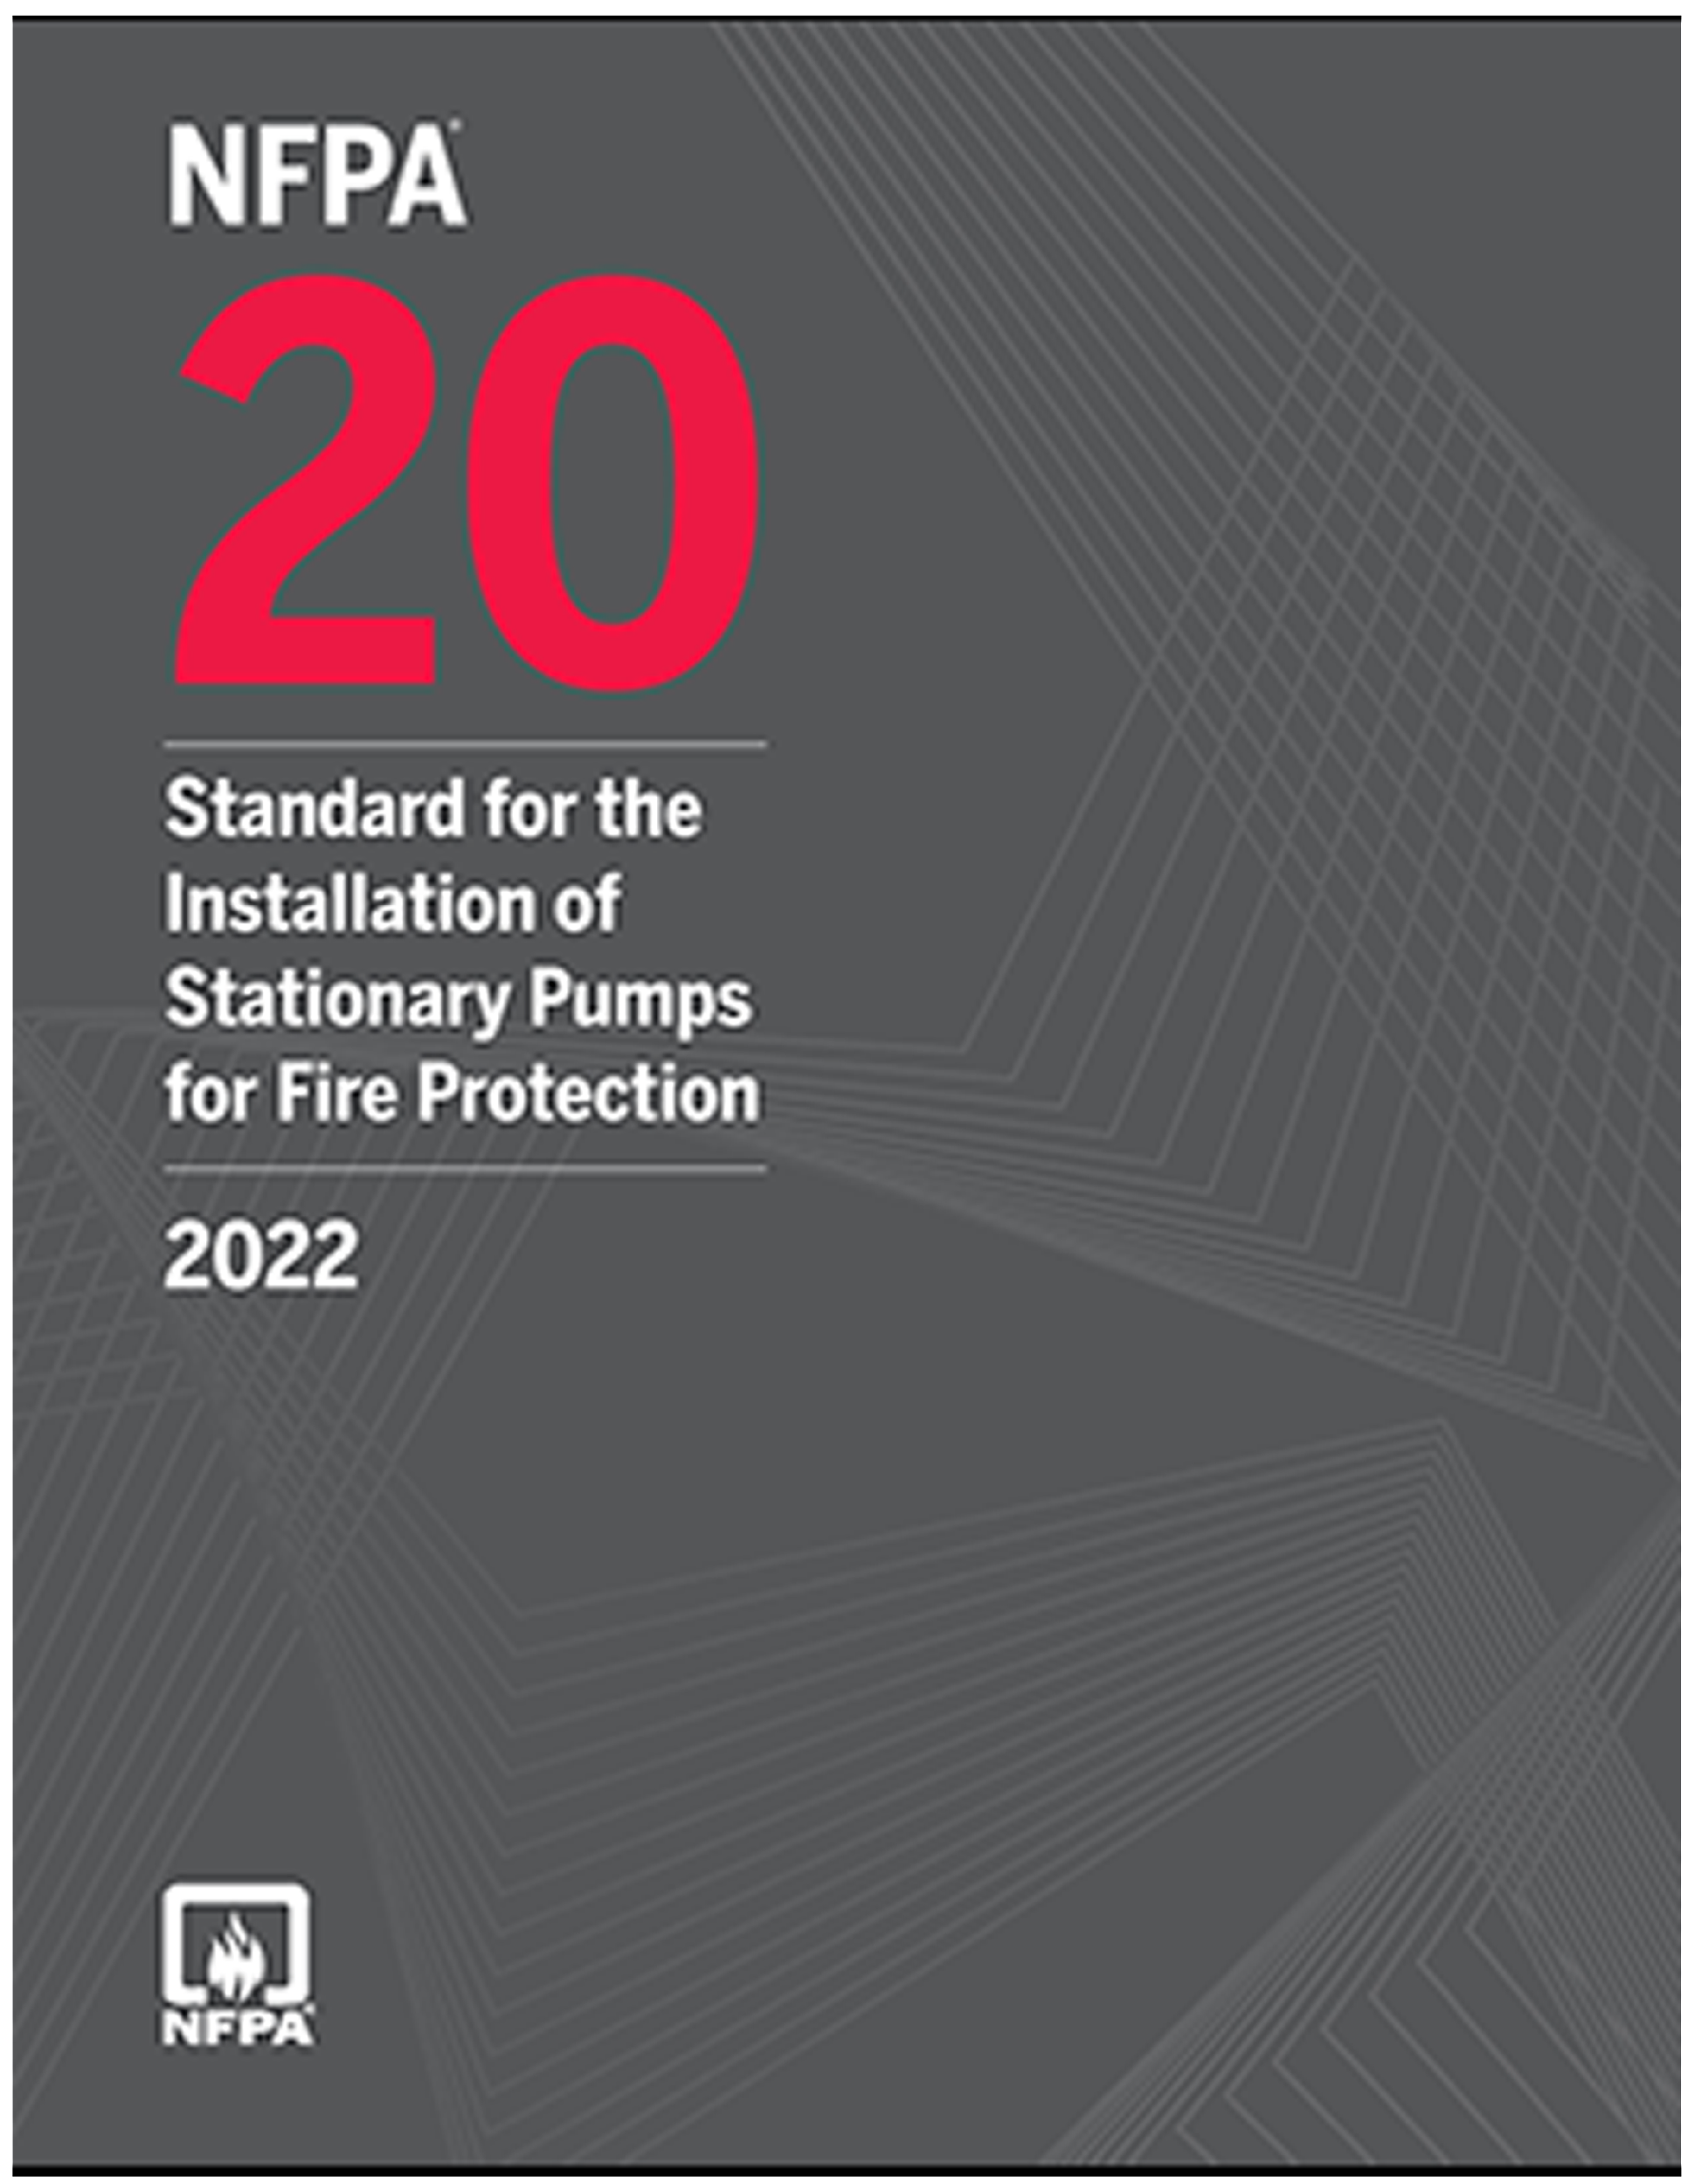
Referenced Publications
Reproduced with permission of NFPA®, which owns all rights thereto. This reprinted material is not the complete and official position of the NFPA on the referenced subject, which is represented only by the standard in its entirety. For a full copy, please go to www.nfpa.org.

Slide 5
When is Backflow Prevention Required?
Connection to public water
When is an RPZ required?
Antifreeze
Foam
Corrosion inhibitor
Notes:
Photo Credit: ITM Development

Slide 6
Backflow Types
Double Check Valve Assembly
A double check assembly (DCA) consists of two independently operating spring-loaded check valves.
Double Check Detector Assembly
A double check detector assembly (DCDA) is hydraulically balanced to include a metered bypass assembly to detect system leakage.
Reduced Pressure Zone Assembly
Two independently acting check valves together with a hydraulically operating, mechanically independent pressure differential relief valve.
Notes:
Definitions from NFPA 25-2020
Additional information:
DCDA. A double check detector assembly (DCDA) is hydraulically balanced to include a metered bypass assembly to detect system leakage. The main valve assembly and bypass assembly afford equal levels of backflow prevention and are each equipped with two resilient-seated isolation valves and four test cocks required for testing.

Slide 7
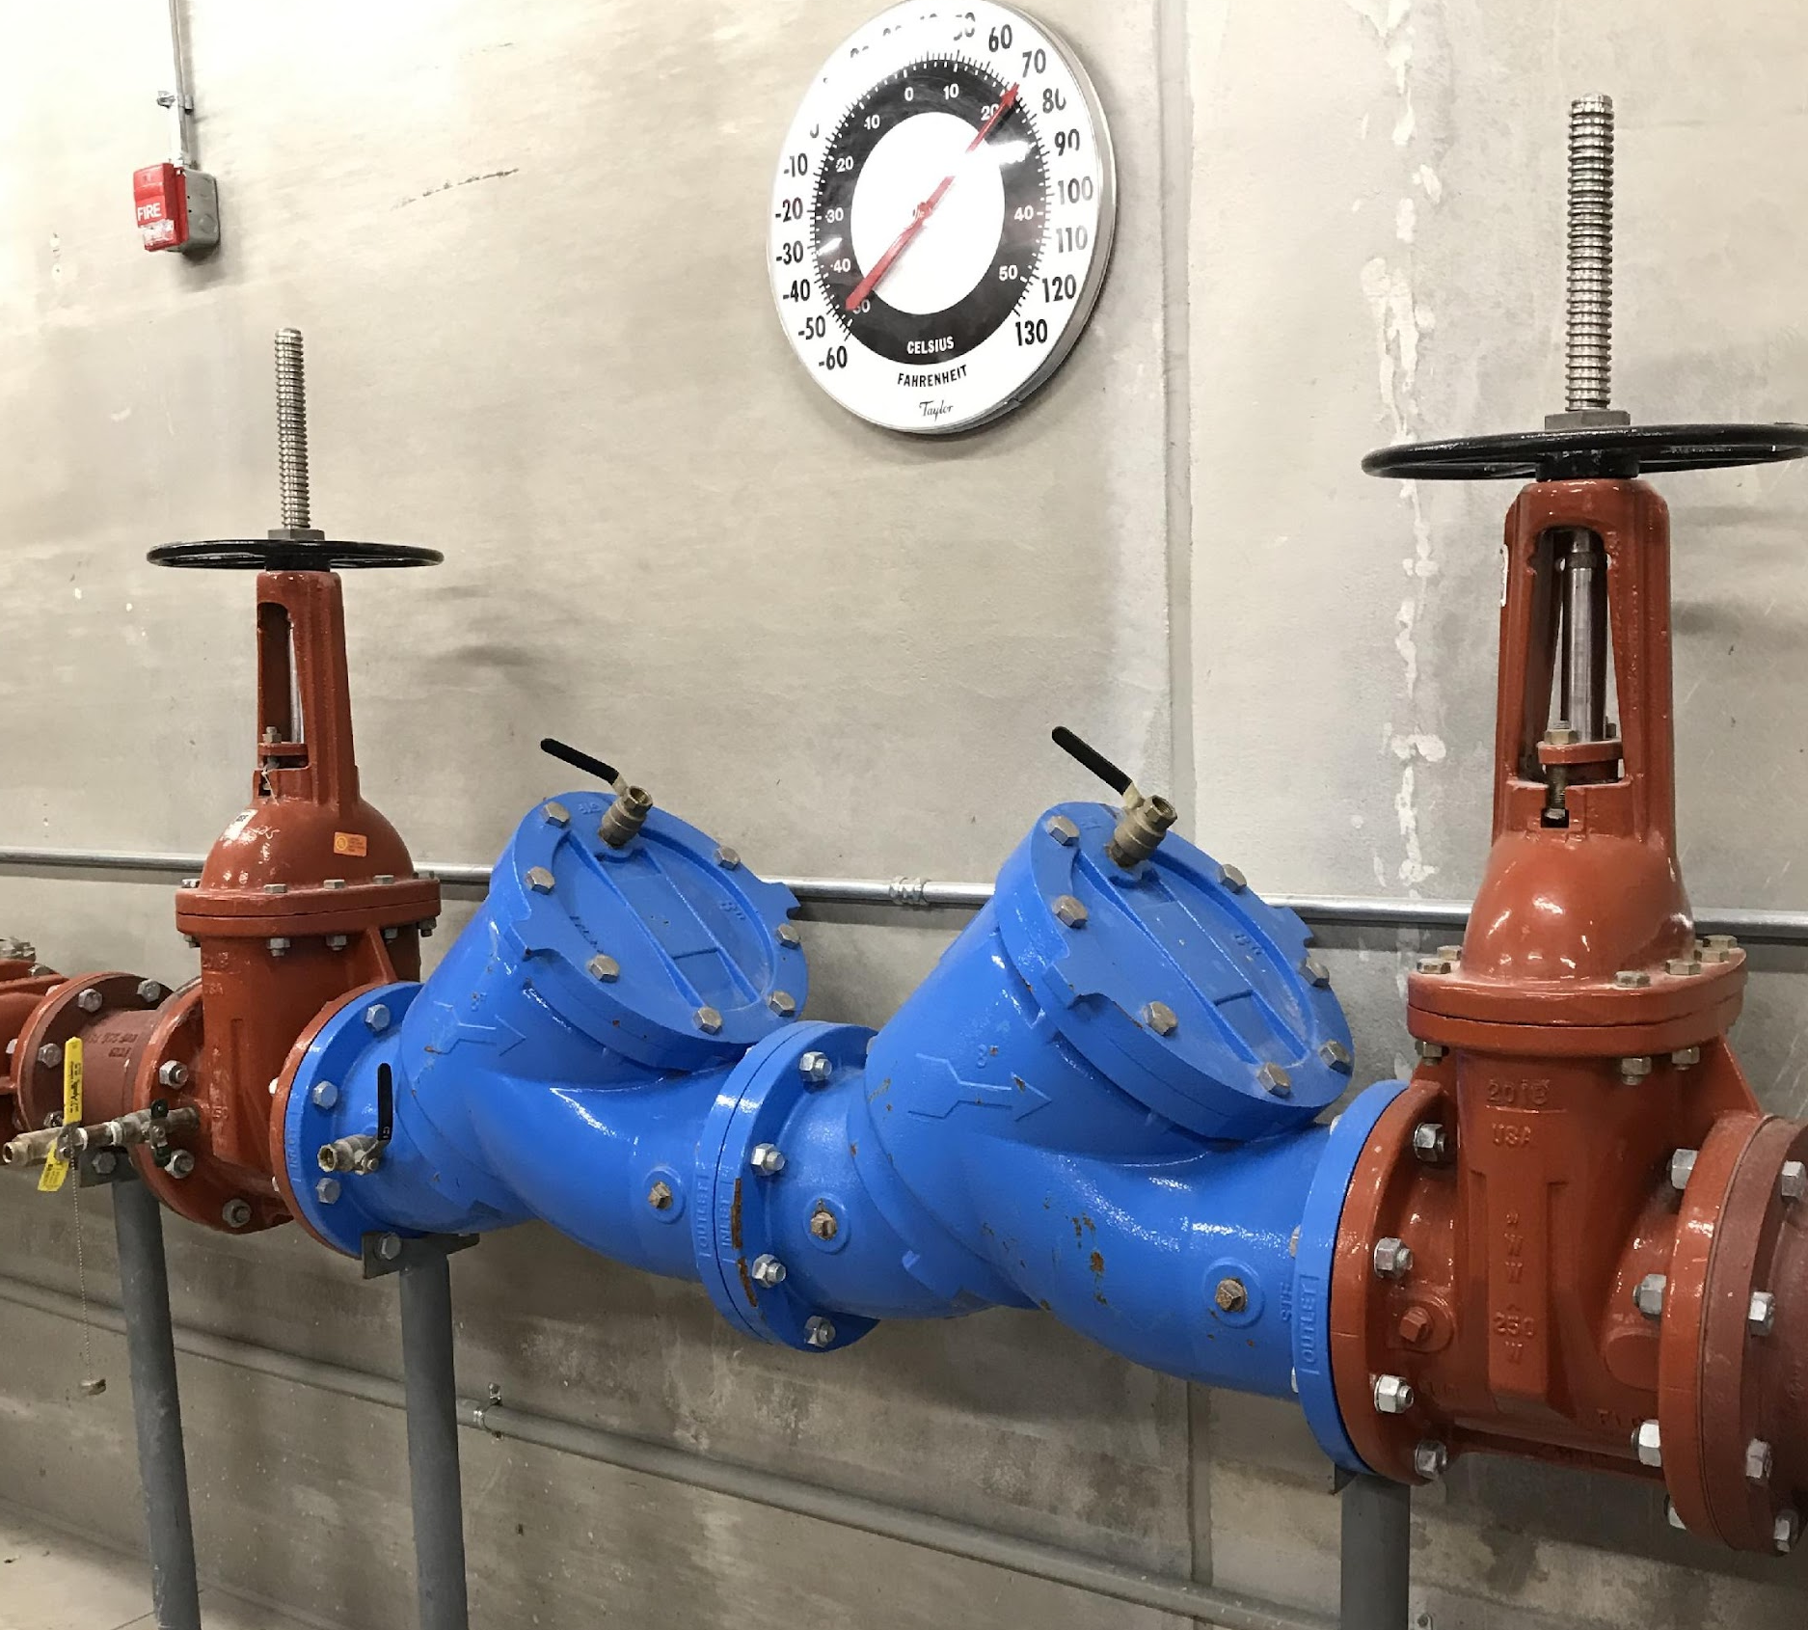
NFPA 20 Backflow Preventer Reqt’s
Must be Listed for fire protection use
Relief valve drainage
Air gap
Discharge requirements
Documentation
Minimum flow: 150 percent of fire pump rating
NFPA 20-2022, Section 4.29
Notes:
NFPA 20-2022:
4.29 Backflow Preventers and Check Valves.
4.29.1
Check valves and backflow prevention devices and assemblies shall be listed for fire protection service.
4.29.2 Relief Valve Drainage.
4.29.2.1
Where the backflow prevention device or assembly incorporates a relief valve, the relief valve shall discharge to a drain appropriately sized for the maximum anticipated flow from the relief valve.
4.29.2.2
An air gap shall be provided in accordance with the manufacturer's recommendations.
4.29.2.3
Water discharge from the relief valve shall be readily visible or easily detectable.
4.29.2.4
Performance of the requirements in 4.29.2.1 through 4.29.2.3 shall be documented by engineering calculations and tests.
4.29.3 Devices in Suction Piping.
Where located in the suction pipe of the pump, check valves and backflow prevention devices or assemblies shall be located a minimum of 10 pipe diameters from the pump suction flange.
4.29.3.1
Where a backflow preventer with butterfly control valves is installed in the suction pipe, the backflow preventer is required to be at least 50 ft (15.2 m) from the pump suction flange (as measured along the route of pipe) in accordance with 4.16.5.4.
4.29.4 Evaluation.
4.29.4.1 Backflow Prevention Device.
4.29.4.1.1
Where a backflow prevention device or assembly is installed in connection with the pump, special consideration shall be given to the increased pressure loss resulting from the installation.
4.29.4.1.2
Where a backflow prevention device is installed, the final arrangement shall provide effective pump performance at the lowest permissible suction pressure.
4.29.4.1.3
The discharge flow rate shall meet or exceed the fire protection system design flow.
4.29.4.1.4
The discharge flow rate shall meet or exceed 100 percent of the fire pump rated flow rate.
4.29.4.1.5
Determination of effective pump performance shall be documented by engineering calculations and tests.
4.29.4.1.6
Retroactive installation of a backflow prevention device shall not reduce the suction pressure below that permitted in this standard and accepted by the authority having jurisdiction.
4.29.4.1.7
Retroactive installation of a backflow prevention device shall not result in a discharge pressure that does not meet the maximum system demand and 100 percent of the rated flow rate for the fire pump.

Slide 8
Suction or Discharge?
Discouraged in fire pump piping due to pressure losses and potential for interruption of flow
Placement on discharge side ensures acceptable flow characteristics to the pump suction.
Avoid cross-connection if jockey pump installed
Allowed in suction where required by AHJ
10 pipe diameters/50 ft
OS&Y or butterfly w/50 ft
Complete evaluation required (friction loss and turbulence)
NFPA 20-2022, Section A.4.16.9
Notes:
NFPA 20-2022:
A.4.16.9
The term device as used in this subsection is intended to include, but not be limited to, devices that sense suction pressure and then restrict or stop the fire pump discharge. Due to the pressure losses and the potential for interruption of the flow to the fire protection systems, the use of backflow prevention devices is discouraged in fire pump piping. Where required, however, the placement of such a device on the discharge side of the pump is to ensure acceptable flow characteristics to the pump suction. It is more efficient to lose the pressure after the pump has boosted it, rather than before the pump boosts it. Where the backflow preventer is on the discharge side of the pump and a jockey pump is installed, the jockey pump discharge and sensing lines need to be located so that a cross-connection is not created through the jockey pump.

Slide 9
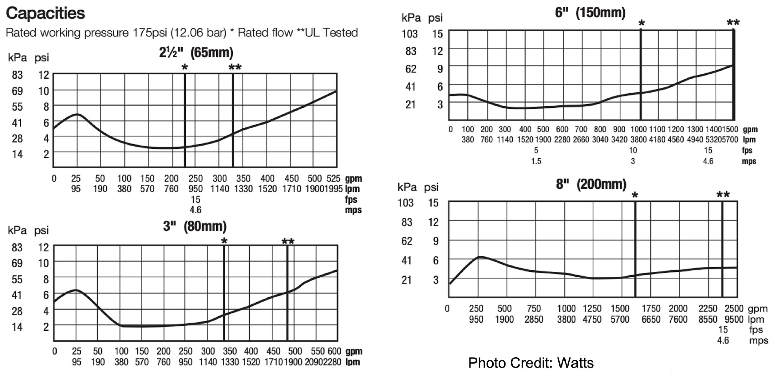
Friction Loss Curves

Slide 10
Installation
Provide a means downstream to forward flow test
Required flow
System demand
Applicable hose allowance
Means cannot require modification
Verify at acceptance
Reproduced with permission of NFPA®, which owns all rights thereto. This reprinted material is not the complete and official position of the NFPA on the referenced subject, which is represented only by the standard in its entirety. For a full copy, please go to www.nfpa.org.

Slide 11
Forward Flow Requirements
System demand
Total demand

Slide 12
Installation Requirements
NFPA 13-2022
16.9.3.3.5 A listed backflow prevention assembly shall be permitted to be considered a control valve, provided both control valves are listed for fire protection system use and an additional control valve shall not be required.
16.9.4.2 A listed backflow prevention device shall be considered a check valve, and an additional check valve shall not be required.
NFPA 20-2022
4.17.7* A listed check valve or backflow preventer shall be installed in the pump discharge assembly.
Reproduced with permission of NFPA®, which owns all rights thereto. This reprinted material is not the complete and official position of the NFPA on the referenced subject, which is represented only by the standard in its entirety. For a full copy, please go to www.nfpa.org.
NFPA 13-2022 & NFPA 20-2022
Notes:
NFPA 13-2022:
16.9.3.3.5
A listed backflow prevention assembly shall be permitted to be considered a control valve, provided both control valves are listed for fire protection system use and an additional control valve shall not be required.
16.9.4.2
A listed backflow prevention device shall be considered a check valve, and an additional check valve shall not be required.
NFPA 20-2022:
4.17.7*
A listed check valve or backflow preventer shall be installed in the pump discharge assembly.
Photo Credit: AFSA Property

Slide 13
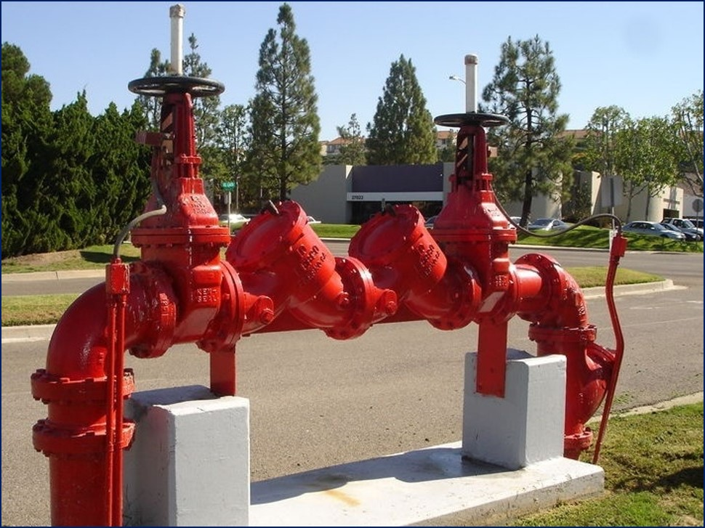
Installation Requirements, Cont’d
NFPA 13-2022
16.14.5.1* Backflow Prevention Valves.
A test connection shall be provided downstream of all backflow prevention valves for the performance of forward flow tests required by this standard and NFPA 25 at a minimum flow rate of the system demand including hose allowance where applicable.
Reproduced with permission of NFPA®, which owns all rights thereto. This reprinted material is not the complete and official position of the NFPA on the referenced subject, which is represented only by the standard in its entirety. For a full copy, please go to www.nfpa.org.
NFPA 13-2022, Section 16.14.5.1
Notes:
NFPA 13-2022:
16.14.5.1* Backflow Prevention Valves.
A test connection shall be provided downstream of all backflow prevention valves for the performance of forward flow tests required by this standard and NFPA 25 at a minimum flow rate of the system demand including hose allowance where applicable.
Photo Credit: AFSA Property

Slide 14
Backflow Prevention Valves
2.5 in. valve downstream per 250 gpm of flow rate
Existing hose connection downstream are permitted
Other means not requiring modification also permitted
NFPA 13-2022, Sections 16.14.5.1.1 – 1.3
Notes:
NFPA 13-2022:
16.14.5.1.1
A 2 1⁄2 in. (65 mm) hose valve shall be provided downstream of the backflow prevention valve for every 250 gpm (950 L/min) of flow rate required by the system demand including hose allowance where applicable.
16.14.5.1.2*
Existing hose connections downstream of the backflow prevention valve shall be allowed to be utilized.
16.14.5.1.3*
Other means shall be permitted as long as the system doesn't require modification to perform the test and it is sized to meet the system demand.

Slide 15
Contractor’s Material and Test Certificate for Aboveground Piping
Reproduced with permission of NFPA®, which owns all rights thereto. This reprinted material is not the complete and official position of the NFPA on the referenced subject, which is represented only by the standard in its entirety. For a full copy, please go to www.nfpa.org.
NFPA 13-2022, Figure A.29.1
Notes:
NFPA 13-2022:
Figure A.29.1

Slide 16
What do you “means?”

Slide 17
Shop Drawings
Location and labeling of forward flow connections required
NFPA 13-2022, Section 28.1.3 (18)
Notes:
NFPA 13-2022:
Section 28.1.3 (18)

Slide 18
For additional questions regarding the content in today’s presentation, please contact:
John August Denhardt, P.E., ET, CWBSP, FSFPE
Vice President of Engineering and Technical Services
American Fire Sprinkler Association
jdenhardt@firesprinkler.org
214-349-5965 x121
You can contact the AFSA Technical Services staff at technical@firesprinkler.org.

