Slide 1
IoT - Connect, Control, Conserve

Slide 4
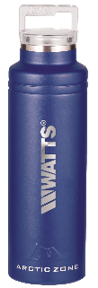
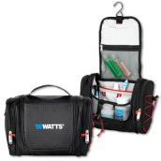
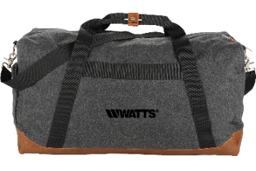
TRAINING ON THE GO!
LEARNING DOESN’T END HERE!!
Learn & Earn incentive program
On demand from any device
Self-paced courses <10 minutes
PRODUCT CATEGORIES
Plumbing and Flow Control
HVAC & Hot Water
Drainage
Water Quality
Thermal
water bottle
Toiletry
bag
Charles River® pullover
windbreaker
Camping
chair
Beer tasting flight set
Register today at Training.Watts.com
Field & Co.® weekend duffel bag
Midnight blue Sherpa blanket
Learn & Earn merchandise is subject to change without notice.

Slide 5
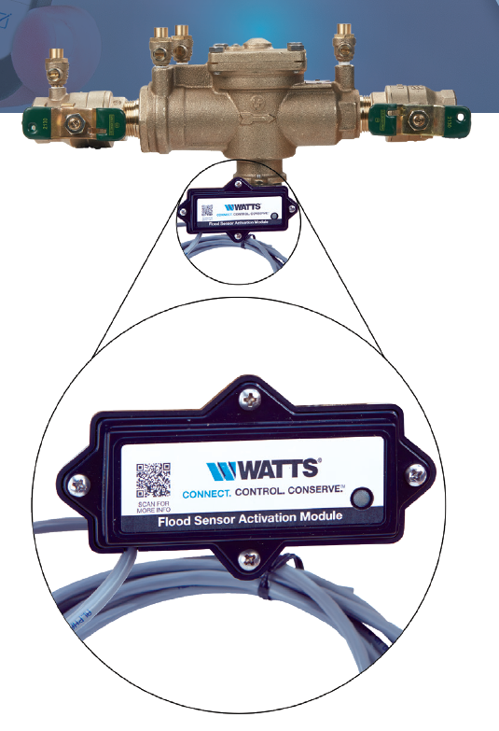
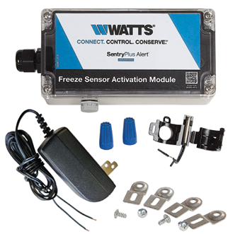
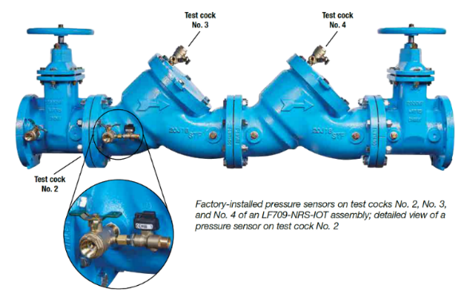
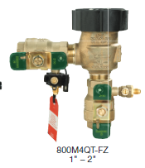
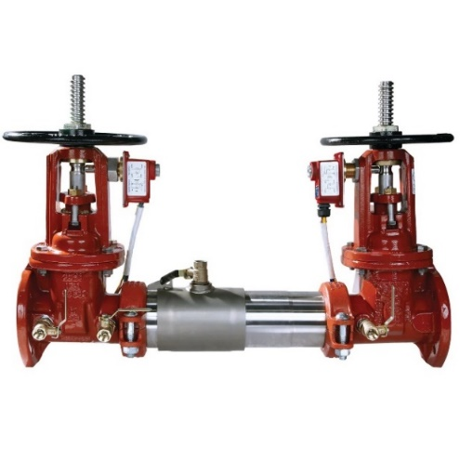
Backflow Prevention IoT Solutions
Leak / Flood Detection
Fire Tamper Detection
Performance Monitoring
Temperature Sensing
A Safety Device that indicates Open / Close position of OS&Y Gates in Fire Sprinkler Systems
Live pressure readings sent directly to BMS/BAS Identify potential issues before they become a major health event
Live pressure readings sent directly to BMS/BAS Identify potential issues before they become a major health event
The add-on sensor connection kit is available for both third-party building management systems, or BMS, and cellular communications

Slide 6
PVS-7000 Flood Protection Valve Station
w/ SentryPlus Alert™ Technology
Notes:
Today I am going to discuss with you two new products that were released by Watts at the AHR show in January of this year (2019).
The two new products are the PVS-7000 Flood Protection Valve Station coupled with a new wireless cellular technology called the SentryPlus Alert™
Watts has offered a flood protection system for many years (~10 years) that was predicated on the LFF113FP Flood Protection Shutdown ACV.
The LFF113FP ACV is basically a shutoff valve. It is designed so that when a discharge is sensed from an Reduced Pressure Zone Assembly (RPZ) relief valve, the ACV It will shutoff the water supply to the RPZ. There are many hundreds of these assemblies installed across the United States.
The challenge faced by Specifying Engineers and Contractors today is the inability to order a complete flood protection system under a single ordering code that would include all of necessary components.
Additionally, some municipalities require a shutoff valve and strainer to be installed before the flood protection system.
Watts provides a preconfigured solution for Engineers and Contractors that addresses both of these needs.
This allows Engineers and Contractors to order complete Flood Protection Systems that are pre-configured, assembled, and tested for all three of our backflow preventer brands: WATTS (LF909), Watts (957), and FEBCO (LF860).

Slide 7
What is SentryPlus Alert™ Technology?
Continuous relief valve discharge from a Backflow Preventer can overwhelm a building’s drainage systems. The PVS-7000 flood protection system with SentryPlus Alert™ technology is the only connected flood detection system with an option for automatic water shut-off capability and that can be added to upgrade to any RPZ backflow preventer to provide real-time flood detection.
Now you can receive alerts no matter where you are with SentryPlus Alert™ technology; sending notifications via text, email, and phone call via cellular connectivity through the Syncta® Mobile App.
Watts’ Introduction of IoT Enabled Flood Protection System
Notes:
Our existing flood protection system is a stand alone system that has the ability to connect to the Building Management System (BMS) if there is one.
However, if the Flood Protection System is not connected to a BMS and a flood event occurs and the water is shut off, no one knows until someone turns the faucet on no water comes out. This is a concern that numerous customers have stated.
Worse yet, if the RPZ Backflow Prevention Assembly is not connected to a shutoff device like an Automatic Control Valve (ACV) the flood event can result in many thousands of dollars of water damage to the property.
Most RPZ backflow preventers today do not have any type of flood protection or detection system installed with/on them.
Less than 10 percent of our backflow assemblies installed to date are connected to a BMS system. Why, because they are installed in older buildings that may not have a BMS system Even when they are connected, it may only be to a panel that provides a visible lighted indication or an alarm. But if no one is in the building to take corrective action when a flood event occurs, the condition may persist for several hours or even days. Which could result in significant or even catastrophic damage.
In response, Watts has introduced a wireless technology that connects to the existing Flood Protection System that will notify the building owner when a flood event has occurred and the water has been shut off.
You have the option to be notified by several means to include: Text, Email and Phone, This is a significant differentiator and advantage from our existing competitors in this market space today.

Slide 8
Product Brief
Lead-Time
5 Days
[Upon order receipt]
Connectivity
BMS +
Cellular
w/ mobile App
APPLICATION
Existing and New Installations with Flood Protection ACV and/or Backflow Preventers
Notifications
Real-time
CONFIGURATION
Standard Item Ordering Codes
Reduced Lead-Times
Easier to Purchase
4 Application Solutions
Powered by Syncta
Direct Notification Service
Notes:
The Target Markets for this product are Commercial Plumbing and Irrigation. You will notice Fire Suppression is not listed.
That is because you do not want to stop water to the Fire Suppression System.
The product will Go To Market through the Wholesales Channel. It is not a Direct Sales or through Original Equipment Manufacturer (OEM).
Basically how that works is, an engineer will specify the product and a contractor will pick it up and install the product.
There is also an upgrade kit that is designed specifically for the Contractor to sell to existing RPZ installations
From an Application Standpoint this product is unique in that it can be used in new installations or it can be used to upgrade existing installations.
The main differentiation is that it is not just WATTS, FEBCO, and AMES. This also includes competitors products in sizes 2 ½” – 10” diameter.
The system comes Preconfigured and can be ordered using a single Standard Ordering Code.
Using the standard ordering codes results in Reduced Lead Times.
Previous systems were made –to-order systems that took 6-12 weeks.
Using the new standard ordering codes, in now takes only 5 days after receipt of an order to ship the new system, preconfigured and on a skid, ready for installation.
Preconfigured systems are pre tested in the factory
Result in fewer connection points
Significant reduction in installation time
These systems are currently available only in the United States and Canada.
SentryPlus is a cellular technology not Wi-Fi. The reason it is not Wi-Fi due to customer concerns regarding the security and bandwidth use of their IT infrastructure.
This approach alleviates the use of the customers IT Infrastructure. The only time it would connect to customer IT Infrastructure is if the customer connects the system to the Building Management System (BMS).
Watts owns a company called Syncta. Syncta is a cloud based asset management system specifically developed for Backflow Testers.
When you purchase and install a SentryPlus Alert System you have to register the system in order to have cellular communication.
This is done using the Syncta platform.

Slide 9
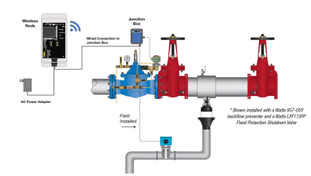
On Technology – 4 Application Solutions
PVS-7000
Flood Protection Valve Station
FLOOD DETECTION SYSTEM
Backflow + ACV + IoT Connectivity existing but adding wireless
Backflow + IoT Connectivity
LFF113FP
UPGRADE KIT
ACV + IoT Connectivity
FS99 + Control panel + IoT connectivity node + 2“ Tee (PVC)
Flood Protection Valve Station
Upgrade kit for either existing Backflow or ACV installation
Note: Wireless node not shown to scale – size increased for purpose of presentation
Notes:
This is where Watts Food Protection/Detection solution differs. Watts offers the technology in 4 different Application Solutions.
The two images on the left side of the screen represent the flood protection application solutions.
The two images on the right side of the screen represent the flood detection application solutions.
This provides you with the ability to configure the SentryPlus Alert solution based on application, environment, and basic needs.
In the slides that follow I will discuss each solution in greater detail.

Slide 10
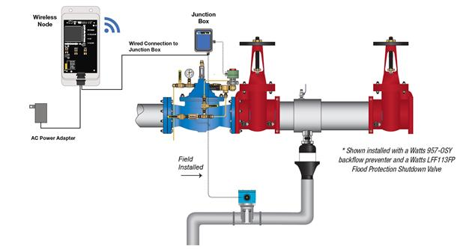
The PVS-7000 Flood Protection Valve Station
A range of pre-configured, price listed valve stations, Backflow, and ACV ranging from 2 ½” to 10” line size.
BMS Connectivity + Full wireless capability, Connects the device with you, and/ or your service professional in one simple system, sending YOU and alert when continuous relief valve discharge through the drain pipe is sensed by the Flow Sensor
RPZ Backflow preventer to protect the potable water supply from contamination that can occur from Back Syphonage or Backflow Pressure events
A Sophisticated Water shut-off ACV, specifically designed to shut off the incoming water supply should an RPZ discharge event occur
PVS-7000 Valve Station Configuration Options
PVS-7110 | PVS-7120 | PVS-7210 | PVS-7220 | PVS-7310 | PVS-7320
PVS-7000 w/ 957-NRS | PVS-7000 w/ 957-OSY | PVS-7000 w/ LF909-NRS | PVS-7000 w/ LF909-OSY | PVS-7000 w/ LF860-DNRS | PVS-7000 w/ LF860-DOSY
Note: Wireless node not shown to scale – size increased for purpose of presentation
Notes:
Here is the PVS-7000 with SentryPlus Alert Flood Protection Backflow System.
Systems incudes: Backflow Preventer, Automated Flood Protection Shutdown Valve (ACV), Flow Sensor, Junction Box, and Wireless Node.
Can be installed inside or outside
How it works when a flood event occurs:
Water discharge through the backflow preventers relieve valve is detected by the Flow Sensor.
Flow Sensor sends an electronic signal to the Junction Box which starts the Timer (timer is configurable, usually set for (15-30 seconds)
If the Timer expires an electronic signal is sent to activate a Relay which in turn send an electronic signal to activate a Solenoid
The Solenoid allows water onto the cover of the ACV which closes the valve and stops the flow of water.
While the Solenoid is activated, a signal is sent to the Wireless Cellular Node to send a flood event message to the Syncta Platform
Syncta will send out notification of a flood event to those identified in the registration process by Text, Email, and Phone. (generally within 10-30 seconds after an event has occurred depending on who your wireless service provider is and the performance of the network).
The message is sent when the discharge is first detected and then again when the discharge is stopped – giving the Facility Engineer peace of mind that water damage risk has bene minimized
This solution can be configured with WATTS, AMES, or FEBCO backflow assemblies.
You can order the system with the shutoff valve of your choice: Non-Rising Stem (NRS), Outside Stem and Yoke (OSY), and Quarter Turn (QT) for the WATTS version of backflow preventer.
If you want to add Pressure Regulation you can, such as by placing a Pressure Reducing ACV after/downstream the Flood Protection Valve Station.

Slide 11
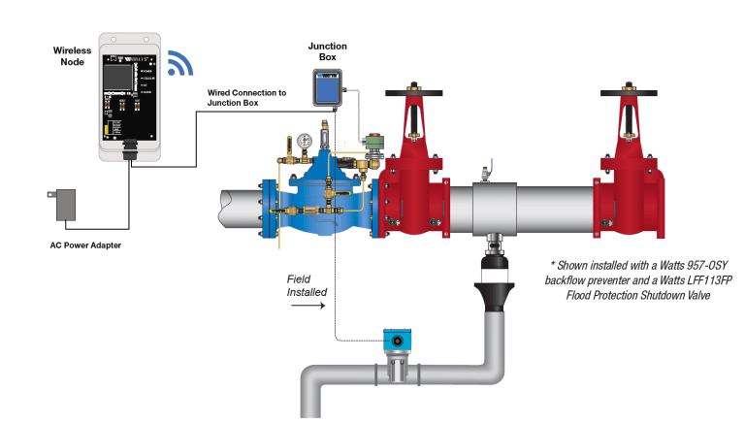
LFF113FP Universal Flood Protection ACV
LFF113FP Flood Protection Shutdown ACV is a normally open valve designed to be installed upstream of a Reduced Pressure Zone (RPZ) Backflow Prevention device of any manufacturer.
This normally open ACV, closes when continuous relief valve discharge through the drain pipe is sensed by the Flow Sensor, energizing the Solenoid Pilot.
SCADA Connectivity + Full wireless capability, connects the device with you, and/ or your service professional alerting him of the failure and also taking fail-safe action.
These universal ACV assemblies range from 1-¼” to 10” line size.
Can be connected to any RPZ Backflow OR in-line on any pipeline application w/ attached drain-line
Note: Wireless node not shown to scale – size increased for purpose of presentation
Notes:
Here is the SentryPlus Alert Flood Protection Shutdown Valve.
Systems incudes: Automated Flood Protection Shutdown Valve (ACV), Flow Sensor, Junction Box, and Wireless Node.
This system can be connected to any RPZ Backflow. Or in-line on any pipeline application w/attached drain-line.
Can be installed inside or outside
How it works when a flood event occurs:
Water discharge is detected by the Flow Sensor. (either from backflow preventer relief valve or in-line pipeline application)
Flow Sensor sends an electronic signal to the Junction Box which starts the Timer (timer is configurable, usually set for (15-30 seconds)
If the Timer expires an electronic signal is sent to activate a Relay which in turn send an electronic signal to activate a Solenoid
The Solenoid allows water onto the cover of the ACV which closes the valve and stops the flow of water.
While the Solenoid is activated, a signal is sent to the Wireless Cellular Node to send a flood event message to the Syncta Platform
Syncta will send out notification of a flood event to those identified in the registration process by Text, Email, and Phone. (generally within 10-30 seconds after an event has occurred depending on who your wireless service provider is and the performance of the network).
The message is sent when the discharge is first detected and then again when the discharge is stopped – giving the Facility Engineer peace of mind that water damage risk has bene minimized

Slide 12
Flood Detection System
IoT enabled Flood Detection system, sends you an alert when continuous relief valve discharge through the drain pipe is sensed by the Flow Sensor.
RPZ Backflow preventer protects the water supply from contamination that can occur from Back Syphonage or Backflow Pressure events
BMS Connectivity + Full wireless capability, connects the device with you, and/ or your service professional(s) alerting of a possible flood condition.
Flood detection assemblies range from 2 ½” to 10” line size.
Flood Detection Backflow Configuration Options
957-NRS ALERT | 957-OSY ALERT | LF909-NRS ALTER | LF909-OSY ALERT | LF860-DNRS ALERT | LF860-DOSY ALERT
Note: Wireless node not shown to scale – size increased for purpose of presentation
Notes:
Here is the SentryPlus Alert Flood Detection Backflow System.
Systems incudes: Backflow Preventer, Flow Sensor, Junction Box, and Wireless Node.
Shown install on a WATTS 957-OSY
Typically you will see this in installation where you have an existing RPZ installation, when you may not have the space to include an ACV, or a an application or building where you cannot shut the water off (like a hospital).
The water is not turned off with this system. However, notification that a flood event has occurred will still be sent and the response time to take action will be reduced dramatically.
Because instead of finding out by accident that a flood event occurred, people will know by design that an event has happened.
Can be installed inside or outside
How it works when a flood event occurs:
Water discharge through the backflow preventers relieve valve is detected by the Flow Sensor.
Flow Sensor sends an electronic signal to the Junction Box which starts the Timer (timer is configurable, usually set for (15-30 seconds)
If the Timer expires an electronic signal is sent to the Wireless Cellular Node to send a flood event message to the Syncta Platform
Syncta will send out notification of a flood event to those identified in the registration process by Text, Email, and Phone. (generally within 10-30 seconds after an event has occurred depending on who your wireless service provider is and the performance of the network).
The message is sent when the discharge is first detected and then again when the discharge is stopped – giving the Facility Engineer peace of mind that water damage risk has bene minimized

Slide 13
Universal Upgrade Kit
Universal upgrade Kit retrofits existing Flood Protection ACV or RPZ Backflow installations and is backwards compatible.
BMS Connectivity + Full wireless capability, connects the device with you, and/ or your service professional(s) alerting of a possible flood condition and also taking Fail-Safe action when ACV is installed.
This upgrade is possible without removing the Valves/ Backflow from the line, saving customer time and money
Flood Detection Upgrade Kit Options
SentryPlus Alert™ Upgrade Kit for Existing RPZ Backflow Installation | SentryPlus Alert™ Wireless Upgrade Kit for Existing Watts LFF113FP ACV
FP-RFK-BF | FP-RFK-ACV
Note: Wireless node not shown to scale – size increased for purpose of presentation
Notes:
Here is the SentryPlus Alert Flood Detection Upgrade Kit.
Systems incudes: Flow Sensor, Junction Box, and Wireless Node.
This system can be connected to any RPZ Backflow.
This solution is really designed for Contractors, and is a means for them to revisit existing customer and applications to sell a real VALUE add upgrade
This solution can also be installed on RPZ’s located outside that do not have drain-lines and air-gaps installed, In order to prevent property damage (i.e. landscape, hardscapes, walkways…etc. and prevent water waste.) Connect/Control/Conserve
How it works when a flood event occurs:
Water discharge is detected by the Flow Sensor. (either from backflow preventer relief valve or in-line pipeline application)
Flow Sensor sends an electronic signal to the Junction Box which starts the Timer (timer is configurable, usually set for (15-30 seconds)
If the Timer expires an electronic signal is sent to the Wireless Cellular Node to send a flood event message to the Syncta Platform
Syncta will send out notification of a flood event to those identified in the registration process by Text, Email, and Phone. (generally within 10-30 seconds after an event has occurred depending on who your wireless service provider is and the performance of the network).
The message is sent when the discharge is first detected and then again when the discharge is stopped – giving the Facility Engineer peace of mind that water damage risk has bene minimized

Slide 14
Watts
1
3
SentryPlus Alert™ Technology
is compatible with any
backflow manufacturers existing
RPZ Backflow installations
Meaning existing installations can be upgraded to IoT Smart technology without removing the existing in line hardware
Watts Flood Protection ACV system with SentryPlus Alert™ Technology can be
integrated with any manufacturer’s
RPZ Backflow installations
ONE TECHNOLOGY – 4 APPLICATION SOLUTIONS
2
4
If Flood Protection ACV is installed
upstream of a Backflow RPZ application
it shuts off the incoming water supply
preventing property damage
and water wastage.
SentryPlus Alert™ Technology
is backwards compatible with existing
Watts RPZ Backflow installations and/or
Flood Protection ACVs (Model LFF113FP)
Notes:
The Watts Advantage – How We Are Different
A Watts Flood Protection ACV with SentryPlus Alert Technology can be integrated with any manufactures backflow prevention assembly, and would represent a significant upgrade.
The SentryPlus Alert System is backward compatible with existing WATTS/AMES/FEBO RPZ backflow installations.
Provides you with an opportunity to call on all previous customers to offer this upgrade. Either individually, ACV and SentryPlus Alert or both together.
You can provide just the SentryPlus Alert Technology to any existing RPZ backflow preventer without interruption to the water supply, or the disruption or removal of any existing in line hardware.
The wireless Cellular Node can be mounted up to 100 feet away to ensure good signal strength.
How do you know if you will have a good signal. Pull out your cell phone and see how many bars you have for signal strength.
With an ACV installed upstream of the backflow preventer is the best scenario, shutting off the water supply thereby preventing property damage and water wastage.

Slide 15
How It Works
STEP 1.
STEP 2.
The utility/contractor connects the SentryPlus Alert™ node to the junction box, the facility engineer then registers the device using the added QR Label & Syncta® App; selecting by which method and to who alerts should be sent.
The Flow Sensor continuously monitors for excessive water discharge from the Backflow Preventer and sends a signal to the Smart Electronics Control unit.
STEP 3.
STEP 4.
The Electronics unit analysis the discharge and in case of abnormality; shuts the water off (only if ACV is in loop) and Communicates thru SentryPlus Alert™ Node to Syncta® and/or to the SCADA/ PLC, if present.
Syncta® Sends a message to the user remotely via Text/ Email/ Phone alerting them of the possible abnormal condition and action taken/ to be taken.
Notes:
How Does It Work
Step 1. Once the system is installed. Connect SentryPlus Alert Cellular Node to Junction Box. Node will search for a good signal and establish a connection. Scan the QR code on the side of the cellular node with your cell phone. That will open the Syncta Application. You can the register the device, and then select the method and to who alerts will be sent.
The person who will typically be doing that is the Facility Engineer at the time of commissioning the system. The contractor generally does not register and assign alert parameters for the new system.
Once the system is connected it is pulsed every 15 minutes to ensure that communications are working and the system is okay.
The node is flash upgradable. If ever there were a need for software updates we can push those upgrades down to the node. The upgrade would only go to the Cellular Node.
Step 2. The flow sensor continuously monitors for excessive water discharge. Once water is detected a signal is sent to the Junction Box.
Step 3. If water is constantly sensed for the time set in the timer, a signal will be sent to the solenoid to allow water to the cover of the ACV to shut off the water. If water is not continually sensed, the ACV will not be shut and water will continue to be available as normal.
If you are connected to a BMS, The BMS will also receive a signal that a flood event has occurred and that the ACV has shut off the supply of water.
Step 4. Syncta will sent a message to the user/users remotely via Text/Email/Phone alerting them of an abnormal condition. So that they can take the appropriate corrective action/actions. A message is also sent once the discharge condition has been stopped [water is no longer present in the discharge pipe]
Why Register
If you do not register the device you will not receive any notifications that a flood event is/has occurred.

Slide 16
SentryPlus Alert™ Technology at a Glance
Connects the device with you, and/ or your service professional in one simple system.
Lets You Know Immediately a Flood is Detected.
Long range installation, up to 100ft from junction box, for optimum cellular signal connectivity.
Flexible Installation.
Uses Cellular network for connectivity; overcoming your security concerns relating to connecting to your Wi-Fi networks.
Reliable and Secure Connectivity.
Flash upgradable, enabling performance upgrades to be executed without the need for a service call or take the unit off-line.
Always Current, Always On-Line.
Don’t forget it also connects to your SCADA.
Total Peace of Mind, no matter how you look at it.
Notes:
SentryPlus Alert Technology at a Glance
SentryPlus Alert connects the device to you, and Lets You Know Immediately that a Flood is Detected.
The Cellular Node can be installed up to 100 feet away from the Junction Box, affording Flexible Installations.
The system provides Reliable and Secure Connectivity, alleviating customer IT infrastructure security concerns.
Flash upgradable capability means your system is Always Current, Always On-Line. No need for service call or taking the system off-line for software performance upgrades.
Flash upgrades can not be performed during power outages.
Watts is looking it to battery backup potential.
ACV will fail-safe open allowing water flow in a power outage situation.
Don’t forget to it also connects to the BMS as well – so BMS, Cellular, or both

Slide 17
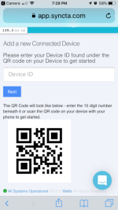
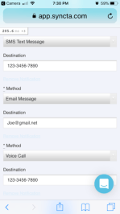
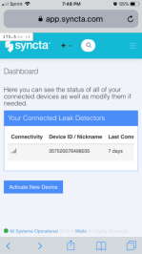
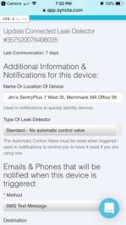
6 Easy Steps for Device Registration
Step 1
Step 2
Step 3
Step 4
Step 5
Step 6
Scroll left on device to edit or delete
Scan the QR Code with your mobile device camera
Registers your device in our asset management cloud
Enter/ confirm your contact details
So we know who you are and where the device is located
Manually enter your Device ID number
Located under QR Code
Tell us how you want to be contacted when a discharge event is detected
Create additional contacts for team notifications
Check your flood protection system connectivity status
Add additional device if needed
Edit Your Device
Give your device a nickname and check methods of communication
Time to also add other contacts for team notifications
Just scan QR code again to access device dashboard
edit or delete device
Notes:
Device Registration
Step 1. Scan the QR Code located on the side of the wireless node with your mobile device camera
Step 2. Enter/confirm your contact details. (Who you are, where the device is located, and who to contact)
Step 3. Manually enter your Device ID number – located below the QR code
Step 4. Enter method(s) by which you want to be contacted (Text/Email/Phone, for each person you want contacted) As many people as you want
Step 5. Check your flood protection system connectivity status then scroll the Device ID to the left to edit or delete the device
You will see the edit/ delete buttons once you scroll to the left
Step 6. Give your device a nick name that makes it easy to identify and find, e.g. 123 East Main Street Wells New Hampshire Floor 3 Office L1234 – this nick name will be provided as part of phone call, text, and Email
This is a goof time to check contact details and also add other people who you want to be contacted

Slide 18
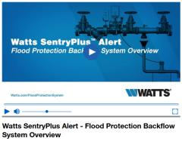
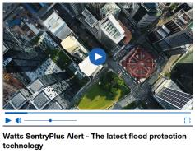
SentryPlus Alert & Flood Protection Resources
Flood Protection Resource Site
Brochure
Engineering Sheets
System Technology Video
Flood Protection Video
Resource Base for Engineers and Contractors
Notes:
Available SentryPlus Alert Flood Protection Resources:
Dedicated Website
Videos
System Technology Video – Breakdown of the system and how it works.
Flood Protection Video – Flood Protection and the Importance of Flood Protection.
Marketing Brochure
Explains the system, flood protection, system configuration
Engineering Sheets
Specification Sheets, IOM’s

Slide 19
Thank You
If you would like to learn more about the Watts PVS-7000 Flood Protection Valve Station with

Slide 20
PVS-7000 Flood Protection Valve Station with
POWERED BY SYNCTASM

Slide 21
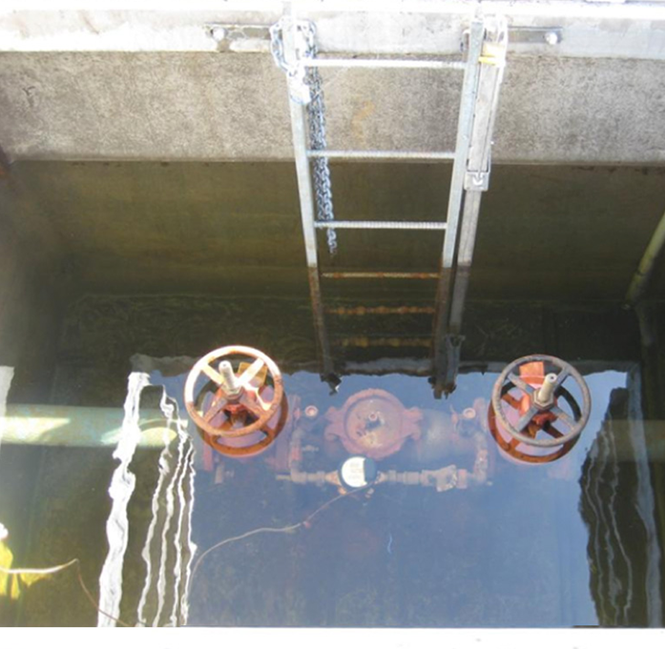
Backflow Assemblies in Vaults
Hazardous confined spaces are expensive and dangerous to maintain and repair equipment
Potential Cross Connections:
“When a backflow preventer is installed below grade, the vault or pit in which an assembly is installed may fill up with water—possibly contaminated water. The water in the pit could create a cross-connection between the water in the pit and the backflow preventer through the test cocks. This may occur whether the test cocks are opened or closed”
USC- FCCHR “Cross Talk, Spring 2014”

Slide 22
HOT BOX® MARKET CERTIFICATION

Slide 23
ASSE is the American Society of Safety Engineers
The ASSE 1060 Certification is related to Outdoor Enclosures for Fluid Conveying Components
Performance requirements for outdoor enclosures used for
backflow prevention assemblies
All standard Hot Box brand products are ASSE 1060 certified
Custom Hot Box units are not listed under ASSE certification however, are manufactured with materials and components which meet the standards set forth by ASSE 1060

Slide 24
Enclosure Classifications
Class I : Freeze Protection (Heated and insulated)
Class II: Freeze Retardant (Insulated)
Class III: Non- Freeze Protection (Uninsulated and unheated)
Maintain +40ºF inside when outside ambient temperature is outside ambient temp is -30ºF

Slide 25
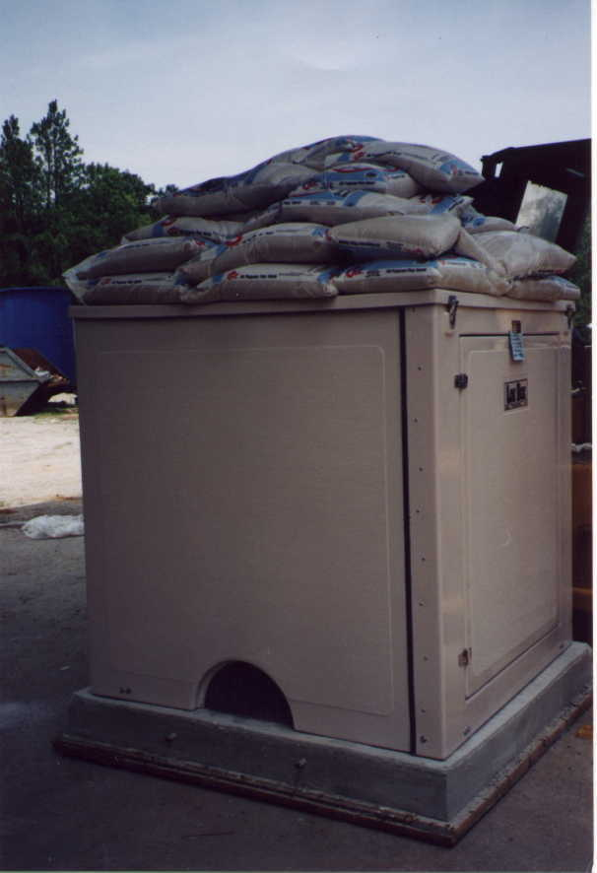
Structural Test
Vertical Load Test
Supporting a minimum vertical load of 100 lbs/sqft such as to simulate a snow load.
Height of 36” (914 mm) the enclosure shall be capable of supporting a minimum vertical load of 200 lbs. concentrated in 1 sqft.

Slide 26
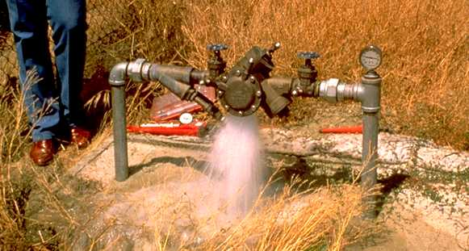
Drain Performance
Drainage capacity is designed into the enclosure dependent on the designated backflow
Part of the certification testing is to ensure excessive water flow will drain properly through manufactured drain ports whether on the end wall or side wall of the unit.

Slide 27
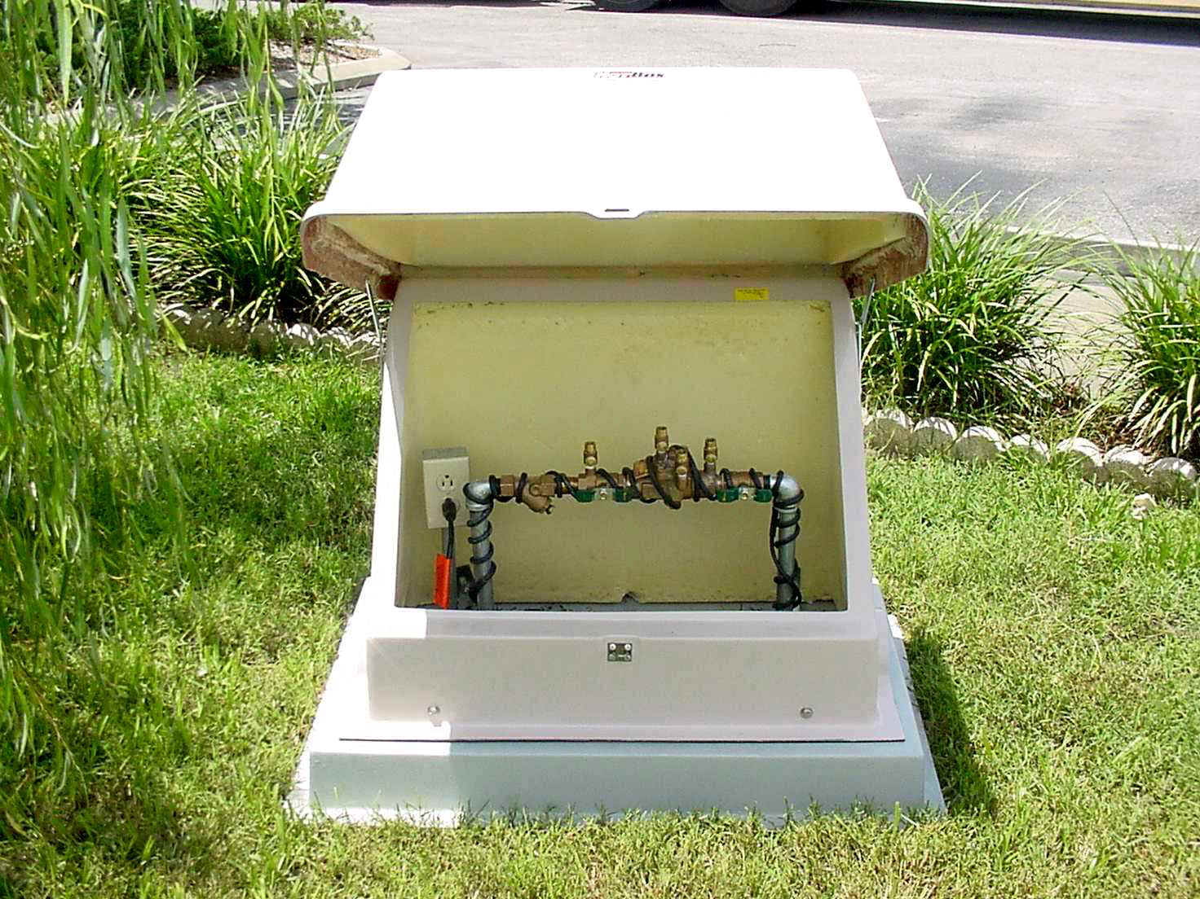
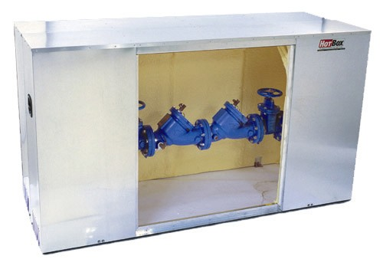
Enclosure Access
Easy access to the backflow is another important part of certification
Units must provide sufficient room for monitoring, testing, maintenance, or replacement of the component located inside of the enclosure
Hinged panels are restrained to avoid injury during monitoring, testing, maintenance, repair, or replacement of the components located inside of the enclosure

Slide 28
Thank You!
Skylar Lipson PO.
slipson@harrywarrenga.com

